Slide 1

Describing Works and Expressions
Module 6

Slide 2
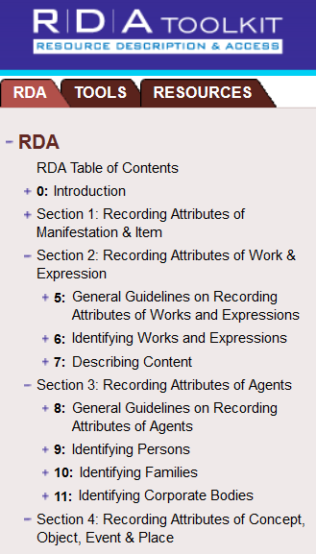
Pertinent Instructions
RDA Chapters 5 and 6
Other RDA chapters when constructing access points that include a personal, corporate, or family name as a creator (chapters 8-11)
Notes:
March 22, 2017

Slide 3
Scope
The purpose of this module is to learn how to describe works and expressions
This workshop does not cover
  Music
  Legal works
  Series
Notes:
May 1, 2013
In this module, we use the attributes of works and expressions recorded according to the instructions in Chapters 5 and 6 to create authorized and variant access points for works and expressions. Some types of works and expressions require specialized instructions and are most pertinent to select communities; constraints of time and expertise cause us to pass over those topics.

Slide 4
Definitions (RDA 5.1.2)
Work = a distinct intellectual or artistic creation, that is, the intellectual or artistic content.
Expression = the intellectual or artistic realization of a work in the form of alpha-numeric, musical or choreographic notation, sound, image, object, movement, etc., or any combination of such forms.
Notes:
March 22, 2017: updated for revised RDA language
Presenter: have class think of examples of works and expressions.

Slide 5
Definitions (RDA 5.1.2)
The terms work and expression can refer to individual entities, aggregates, or components of these entities (e.g., the term work can refer to an individual work, an aggregate work, or a component of a work)
So throughout this presentation “work” and “expression” can refer to collections and parts, as well as individual works or expressions
Notes:
December 14, 2016: updated for revised RDA language

Slide 6


Work and Expressions
Notes:
December 14, 2016: corrected date of translation
“Piedra de Sol” is an example of a work. It is a poem written by Octavio Paz in 1957.
The publication (manifestation) to the left contains an example of an expression: the first Spanish expression of the work.
The publication (manifestation) to the right, published in 1963, contains two expressions: the original Spanish text and an English translation.
Note: The Spanish text is identical in these two publications, so they each contain the same Spanish expression. Represented on this slide are two expressions. The Spanish expression is in both publications; the English expression is only in the publication to the right.

Slide 7
Works and Expressions
Work: Piedra de sol
created by
Person: Octavio Paz
realized through
Expression: English
Expression: Spanish
translated by
Person: Muriel Rukeyser
Notes:
May 1, 2013
This diagram might make this a little clearer. There is one Spanish expression. The same expression is in both publications (to the left of the screen). The publication titled “Sun stone” also has an English expression in it (to the right of the screen). This diagram shows how this might work in an entity-relationship database: we’d have one description of the work, one description of the (original) Spanish expression, and one description of this English expression, all linked by relationship links.

Slide 8
When do you have to create an authority record?
PCC Practice—to create as needed for cataloging
BIBCO—to create to support access points
Notes:
March 22, 2017: updated speaker notes to reflect current language in DCM Z1
The introduction to Chapter Z1 of the Descriptive Cataloging Manual, after laying out the conditions under which LC will create name-title or title authority records, states that “LC/PCC catalogers may contribute name authority records for works or expressions as needed for cataloging.”
BIBCO requires all access points in a BSR (BIBCO Standard Record) to be supported by authority records.

Slide 9
MARC Coding
Works and expressions are coded in X00, X10, X11, and X30
If the authorized access point begins with the authorized access point for the creator, use the same tag as the creator uses (X00, X10, or X11)
If the work/expression does not have an explicit creator, use X30
RDA records for works and expressions are coded “z” in 008/10 (“Rules”) and “rda” in 040 subfield $e.
Notes:
May 1, 2013

Slide 10
Identifying Works: Core Elements (RDA 0.6.6)
Preferred title for work
Identifier for work
Musical works with non-distinctive titles
  Medium of performance
  Numeric designation of musical work
  Key
Notes:
March 22, 2017: added RDA instruction number to slide, updated to reflect current RDA language
Open to 0.6.6, looking for the core elements for works (click through as they find them)
Note again that core elements are required, but do not necessarily wind up in the authorized access point for the work.
Reminder: We are not covering music or legal works in this module.

Slide 11
Identifying Works: Core if needed to distinguish (RDA 0.6.6)
Form of work
Date of work
Place of origin of work
Other distinguishing characteristic of work
Musical works with distinctive titles
  Medium of performance
  Numeric designation of musical work
  Key
Notes:
March 22, 2017: added RDA instruction number to slide, updated to reflect current RDA language
Click to display points as located.

Slide 12
Identifying Works: Core Elements
The author / creator is not a core element of the work entity.
Authors can be persons, families, or corporate bodies, and they are separate entities, related to the work entity--an author has a relationship with a work
However, the access point will contain the name of the author, if there is one. This is a link, not an element of the work entity.
Notes:
May 1, 2013

Slide 13
Identifying Expressions:
Core Elements (RDA 0.6.6)
Core in all cases
Identifier for expression
Content type
Language of expression
Cartographic expression
  Horizontal scale (maps)
  Vertical scale (maps)
Core if needed to distinguish
Date of expression
Other distinguishing characteristic
Notes:
March 22, 2017: updated RDA instruction number and language
Open to 0.6.6, find the core elements for expressions. Click to display points as located.
This module does not cover cartographic works. Presenter—if asked about recording scale in expression authority records, note that no explicit field for scale has been defined in the MARC authority format, and that it’s unclear whether the data would be recorded in subfield $g or $s of a 1XX access point.

Slide 14
Source Consulted (RDA 5.8)
Record in 670 field, or 3XX subfield $u/$v
Always include one 670 for the resource being cataloged
Others included if needed to justify information in the description
Suggested format:
  670 Title proper, date: $b location within source (data found)
Notes:
May 1, 2013
Everyone go to RDA 5.8

Slide 15
Exercise: Source Consulted
Add the Source Consulted element for the original edition of Piedra de sol (published 1957?) to a worksheet or an OCLC authority workform
Notes:
May 1, 2013

Slide 16
RDA 5.8. Source Consulted
  670 Piedra de sol, 1957?: $b title page ([by] Octavio Paz)
  670 Sun stone, 1963?: $b title page (Sun stone = Piedra de sol; [by] Octavio Paz, translation by Muriel Rukeyser)
Notes:
May 1, 2013
Two examples. These 670s show the important information that needs to be recorded for works and expressions: presentations of the title, names of creators, names of contributors (e.g. translators).

Slide 17
Attributes of Works

Slide 18
Titles (RDA 6.2.1)
Information about titles of a work can be taken from any source (RDA 6.2.1.2)
Sources of information for the preferred title are found in RDA 6.2.2.2.
Creating the authorized access point is a further step (RDA 6.27)
Notes:
May 1, 2013
Note the three-step procedure: title of the work→ preferred title→ authorized access point. Note too that RDA divides titles into preferred titles and variant titles.

Slide 19
Transcription and Capitalization
Follow RDA 1.7. General guidelines on transcription (not the alternatives)
RDA 6.2.1.4. Capitalization. Follow Appendix A.3 and A.4.
RDA 6.2.1.6. Diacritical marks: record them as they appear; add them if it is certain that they are integral to the title but were omitted in the source
RDA 6.2.1.7. Omit initial articles (NACO follows the alternative)
RDA 6.2.1.9. Abbreviations. Record only abbreviations that are found in the source.
RDA 5.4. Language and script. NACO policy = Romanize vernacular scripts.
Notes:
May 1, 2013
Review 1.7; LOOK at A.3-A.4 together.
The instructions here on Capitalization, Numbers, Diacritical Marks, Initial Articles Spacing of Initials and Acronyms, and Abbreviations are intended to “set up” the candidates for preferred title. Note the LC/PCC PS for the alternative in 6.2.1.7. Unlike AACR2, where 25.C2 called for initial articles to be omitted unless intended to be filed on, RDA posits initial articles as being part of the title, preferred or variant; the alternative may be serving as a bridge until more agencies make use of software that can allow initial articles to be disregarded in the filing of name-title access points—or until character strings are no longer the principal means of conveying the name of a work or expression.

Slide 20
Transcription and Capitalization
LC-PCC PS 6.2.2.8:
  In authorized access point for series, correct inaccuracies in titles proper for multipart monographs, serials, and integrating resources
  Pre-modern forms of letters (i/j, u/v)
    I/J vowel = i (ITER = iter; ILIAS = Ilias; COMMENTARIJ = commentarii)
    I/J consonant = j (IVS = jus; IVLIVS = Julius; MAIOR = major)
    U/V vowel = u (VRSA = ursa)
    U/V consonant = v (UOX = vox)
    UU/VV = w (VVINDELIA = Windelia)
Notes:
Updated December 16, 2019: updated first bullet; added example in second bullet; added to speaker notes
LC-PCC PS for 6.2.2.8: PCC practice: When creating the authorized access point in a series authority record for a multipart monograph, a serial, or an integrating resource, correct the inaccuracy.
It isn’t clear (yet) whether we correct inaccuracies in titles proper of non-series. (See also 2.3.1.4 for transcribing titles of manifestations:. Inaccuracies. For a serial or an integrating resource, correct obvious typographic errors in the title proper. Make a note recording the title as it appears on the source of information (see 2.17.2.4). In case of doubt about whether the spelling of a word is incorrect, transcribe the spelling as found. Record as a variant title (see 2.3.6) the title of a serial or an integrating resource as it appears on the source of information, if considered important for access.)

Slide 21
Transcription Example
Forms found for title:
Piedra de Sol
PIEDRA DE SOL
Manipulation of capitalization according to Appendix A:
Piedra de sol
Notes:
March 22, 2017: updated RDA Appendix number in speaker notes
Refer to A.1; A.3; A.4; A.53.

Slide 22
Choosing the Preferred Title
RDA 6.2.2.4-6.2.2.7
Two instructions:
  Works created after 1500 and works created before 1501
  Based on date of creation, not of publication
Notes:
May 1, 2013
RDA follows AACR2 in using a dividing point for the date of creation of a work rather than that of its embodiment in a resource. There are several likely reasons for this: 1) works created after 1500 are more likely to be disseminated through publication, which brings a greater standardization; 2) most works created before 1501 do not exist in embodiments that decisively convey the creator’s own name for the work. In both cases, the principal aim is to choose as the preferred title a title by which a work is most commonly known.

Slide 23
Choosing the Preferred Title—Works Created After 1500
Conditions (RDA 6.2.2.4):
  Choose the most commonly identified title in the original language (but not necessarily the original title)
  The title can be found in manifestations embodying the work OR in reference sources.
Notes:
March 22, 2017: updated to reflect current RDA language

Slide 24

Notes:
March 22, 2017: updated speaker notes to reflect current RDA language
An example of the first condition would be the preferred title “Hamlet” for the play by William Shakespeare. The play is commonly identified by the title “Hamlet,” as exemplified both by numbers of embodiments and by citations in reference sources.

Slide 25
Choosing the Preferred Title—Works Created After 1500
If there is no commonly identified title in the original language or in case of doubt, choose the title proper of original edition
An alternative title is not included in the preferred title
      Title proper: Cakes and ale, or, The skeleton in the cupboard
      Preferred title: Cakes and ale
Notes:
March 7, 2019: added example of an alternative title
RDA 6.2.2.8: Do not record an alternative title as part of a preferred title for work.

Slide 26
Alternative Titles – Implications for Bibliographic Records
100 1_ Maugham, W. Somerset $q (William
Somerset), $d 1874-1965, $e author.
240 10 Cakes and ale
245 10 Cakes and ale, or, The skeleton in the
cupboard / $c W. Somerset Maugham.
246 30 Cakes and ale
246 30 Skeleton in the cupboard
Notes:
December 16, 2019
Since the title proper of a manifestation with an alternative title includes the alternative title, but the preferred title does not, that means that to name the work in a bibliographic record, a 240 field with the preferred title will be needed (for works with a creator), or a 130 will be needed (for works named by title only).
Example of work known by title alone:
130 0_ Diggers' story.
245 14 The diggers' story, or, Tales and reminiscences of the golden coast / $c from Westland's earliest pioneers ; [edited] by Carl J. Pfaff.
246 30 Diggers' story
246 30 Reminiscences of the golden coast

Slide 27
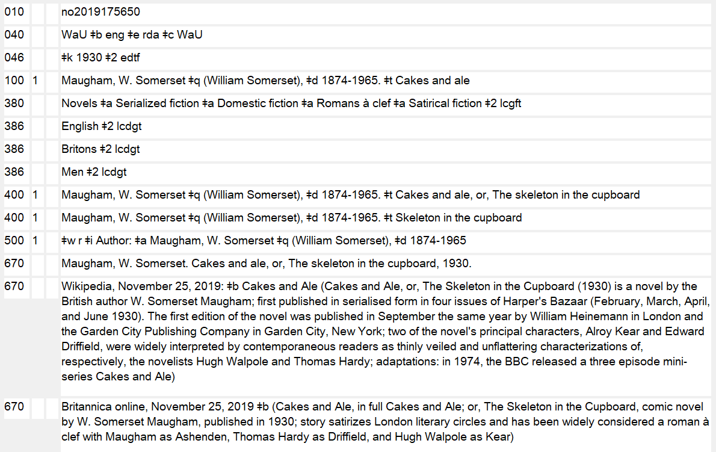
Alternative Titles – Authority Records
Notes:
December 16, 2019
Since the title proper of a manifestation with an alternative title includes the alternative title, but the preferred title does not, that means that to name the work in a bibliographic record, a 240 field with the preferred title will be needed (for works with a creator), or a 130 will be needed (for works named by title only).
Example of work known by title alone:
130 0_ Diggers' story.
245 14 The diggers' story, or, Tales and reminiscences of the golden coast / $c from Westland's earliest pioneers ; [edited] by Carl J. Pfaff.
246 30 Diggers' story
246 30 Reminiscences of the golden coast

Slide 28
Choosing the Preferred Title—Works Created After 1500
If a work is published simultaneously in different languages and the original language cannot be determined: choose the title proper of the first manifestation received by agency
If the language editions are in the same manifestation, choose the title proper named on the preferred source of information (e.g., the title page)
Individual works of art: LC/PCC PS: use English-language reference source
Notes:
March 22, 2017: updated to reflect current RDA language, revised speaker notes
LC-PCC PS 6.2.2.6.1: For individual works of art, the preference for English-language reference sources is tempered by the advice to avoid a reference source that gives all titles in the same language.

Slide 29
Exercise
What is the preferred title?
Notes:
March 22, 2017: updated RDA language in speaker notes
“Piedra de sol” is the title in the original language by which the work is commonly identified.

Slide 30
Choosing the Preferred Title—Works Created Before 1501
RDA 6.2.2.5. Choose the title
  In the original language
  By which the work is commonly identified
  As found in modern reference sources
If reference sources are inadequate, use forms found in (in this order)
  Modern editions
  Early editions
  Manuscript copies
Special rules for Greek and anonymous works
Notes:
March 22, 2017: updated to reflect current RDA language
Notice that reference sources take priority over embodiments of the work, although we still choose a title in the original language in most cases. This reinforces the “commonly-identified” criterion as being the overarching principle behind the instructions.

Slide 31
Choosing the Preferred Title—Works Created Before 1501
Exceptions
  RDA 6.2.2.5: Classical Greek, Byzantine Greek (pre-1453). Choose, in this order:
    A well-established title in language preferred by cataloging agency (English for NACO)
    The Latin title of the work
    The Greek title of the work
  LC-PCC PS 6.2.2.7: Anonymous works, neither in Greek nor Latin alphabet
    A well-established title in English
    If there is none, use the transliterated form of the original title
Notes:
March 22, 2017: anonymous works are no longer an exception in RDA, but the practice is reflected in the LC-PCC PS; revised speaker notes
September 8, 2017: minor wording change in notes, 1st paragraph
The LC-PCC PS to 6.2.2.5 designates English as the preferred language. Neither RDA nor the LC-PCC PS attempts to quantify “well-established.” Take this as a matter of cataloger judgment. If there is more than one English title, choose the title by which, in your opinion, the work is commonly identified.
For Anonymous works, a reminder that the “preferred script” for NACO is the Latin alphabet. Also, if multiple English-language versions of a title exist, with none “established,” the title in the original language is chosen.

Slide 32
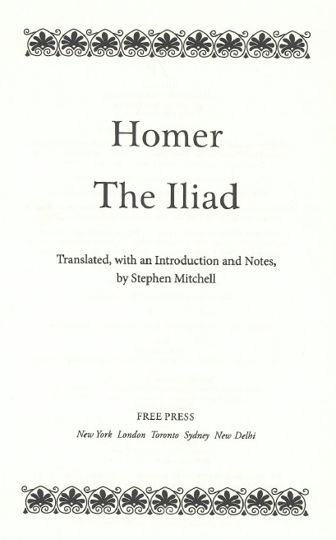
Exercise: Preferred title?
Modern translation,
published 2011
Notes:
September 17, 2018: updated speaker notes
A pre-1501 Greek work—as an exception, we choose a well-established title in English as the preferred title. We can consult reference works to determine the well-established English title.
Exercise: Begin a worksheet (or open an OCLC workform) for this work. Record a 670 for each source as we look at the slides.

Slide 33
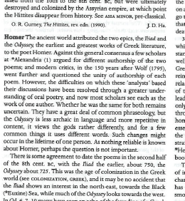
Exercise: Preferred title?
Modern reference
source: Oxford
classical dictionary,
1996, p. 718
Notes:
September 17, 2018: updated speaker notes
A pre-1501 Greek work—as an exception, we choose a well-established title in English as the preferred title. We can consult reference works to determine the well-established English title.

Slide 34
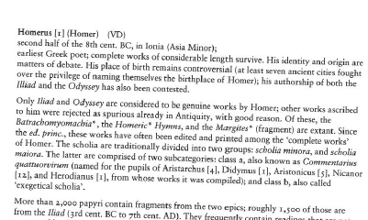
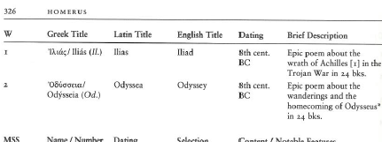
Exercise: Preferred title?
Brill’s new Pauly dictionary of Greek and Latin authors and texts, 2009, p. 325-326
Iliad (English)?
Ilias (Latin)?
Ἰλιάς (Greek)?
Notes:
September 17, 2018: updated speaker notes
A pre-1501 Greek work—as an exception, we choose a well-established title in English as the preferred title. We can consult reference works to determine the well-established English title.
This reference work refers in the main body of the article as Iliad. Because “Iliad” is the well-established English title, that is the title we choose as the preferred title of this work.

Slide 35
Titles in Original Language Not Found or Not Applicable (RDA 6.2.2.6)
Apply when a preferred title in the original language cannot be found either in manifestations embodying the work or in reference sources (e.g., basic story with many versions)
  Choose a well-established title from a modern reference source in a language preferred by the agency creating the data
  Devise a title
Notes:
March 22, 2017: rewrote for general RDA instruction, removed cycles, revised speaker notes
Apply the instructions at RDA 6.2.2.6 for:
1) Works created after 1500 if the title proper of the original edition is not available or the original edition does not have a title proper and reference sources do not contain a title in the original language.
2) Works created before 1500 if a title in the original language is not available in modern reference sources or in manifestations embodying the work because there is no original language or such a title cannot be found.
Situations when this may occur:
- manifestations embodying the work do not contain titles (e.g., some manuscripts, sculptures, choreographic works)
- manifestations embodying the work are not available (e.g., no manifestations of the work are known to exist)
- reference sources do not contain a title for the work in the original language.
What constitutes a “well-established” title is again a matter of cataloger judgment.

Slide 36
Manuscripts/Manuscript Groups
RDA 6.2.2.6: instructions for treating the manuscript as an object (vs. the work contained in it)
  Use the title or name by which the manuscript is commonly identified
    130 _0 Book of Kells
  If none, devise a title:
    [Authorized access point for the repository]. Manuscript. [Repository’s designation for the manuscript]
    110 2_ British Library. $k Manuscript. $n Arundel 384
Apply general instructions (RDA 6.2.2.4-6.2.2.6) to describe the work contained in the manuscript
Notes:
May 12, 2015

Slide 37
Recording the Preferred Title for One or More Parts of a Work (RDA 6.2.2.9)
One part - choose preferred title as already shown
    ... $t Two towers
    … $p Bart gets an elephant
  Can be generic
    … $n Book 1 (e.g., preferred title of a part of Homer’s Iliad)
    … $n Season 2 (e.g. preferred title for a DVD compilation of all episodes of a season of a television series)
      Note: always record the numeric designation as a numeral, e.g. not
      Downton Abbey. Season one. Episode two
    … $p Preface (e.g., for a separately-published preface of a work, such as F. Scott Fitzgerald’s Preface to This side of paradise)
Exceptions:
  Music: RDA 6.14.2.7
  Religious works: RDA 6.23.2.9—6.23.2.20
Notes:
March 22, 2017: updated second exception—applies to religious works, not legal works
See RDA 6.27.2.2 for the placement of the title of the part in the authorized access point. This slide is only concerned with the preferred title of the part.
Under the first bullet: The first example is the second book of the trilogy Lord of the rings, by J.R.R. Tolkein. The second example is an episode from the television program The Simpsons.
Note that the instructions distinguish between part titles and part designations. Designations are defined as “a general term, with or without a numeric or alphabetic designation.”
The instructions for part titles are the basic instructions found at 6.2.1. The instructions for designations call for recording the designation as found, but recording any numeric designation as a numeral.
The general rule calls for part designation to be recorded as the preferred title only when it is the only way in which the part is identified

Slide 38
Recording the Preferred Title for One or More Parts of a Work (RDA 6.2.2.9)
Two or more parts
  Numbered consecutive parts: give the general term in the singular with the number (append to the preferred title of the work)
    … $n Book 1-5, e.g.
      … $t Commentary on the Epistle to the Romans. $n Book 1-5
  Unnumbered or nonconsecutive parts: either
    Record each part separately (i.e. treat each as a single part)
    Or append “Selections” to the preferred title of the work as a whole, e.g., for a compilation called “Soliloquies from Hamlet”
      … $t Hamlet. $k Selections
Notes:
March 22, 2017: reformatted slide
REMEMBER none of these is the complete authorized access point. We shall see that the authorized access point begins with the authorized access point for the creator, which is a link to the description of that person/family/corporate body. We’re JUST recording the title attribute here.

Slide 39
Recording the Preferred Title for One or More Parts of a Work (RDA 6.2.2.9)
Exception for serials and integrating resources with both part designation and part title: record both, with designation first, and separated by a comma
    … $n Series C, $p Traditional skills and practices, e.g.
      130 _0 Marshallese culture and history. $n Series C, $p Traditional skills and practices
Notes:
May 12, 2015
Note the example in RDA (reproduced here) only gives the preferred title for the part, not the full access point (which begins with the preferred title for the work as a whole).

Slide 40
Compilations of Works by One Agent (RDA 6.2.2.10)
Basic instruction: follow the general instructions for choosing preferred titles of works
  If the compilation is commonly identified by a title in manifestations embodying it or in reference sources, choose that title as the preferred title
  Use the following instructions for conventional collective titles only if the compilation is not identified by a title of its own
Notes:
March 22, 2017: updated to reflect current RDA language
Agent = Person, Family, or Corporate Body

Slide 41
Compilations of Works by One Agent (RDA 6.2.2.10)
Conventional collective titles (RDA 6.2.2.10.1-6.2.2.10.2)
  If the compilation purports to be the complete works of an agent, use Works
  If the compilation purports to be the complete works of an agent in a single form, use one of the following:
    Correspondence
    Essays
    Novels
    Plays
    Poems
    Prose works
    Short stories
    Speeches
    Or another appropriate specific collective title such as “Fragments”, “Architectural drawings”, “Posters”, etc.
Notes:
September 17, 2018: deleted LC practice in speaker notes—added to next slide

Slide 42
Partial Compilations of Works by One Agent (RDA 6.2.2.10)
Conventional collective titles (RDA 6.2.2.10.3)
  If the compilation is less than the complete works of the agent
    Either record each work separately
    FORMER PRACTICE:
    and/or append the term “Selections” to the appropriate conventional collective title, e.g.
      … $t Works. $k Selections
      … $t Plays. $k Selections
      … $t Speeches. $k Selections
  NOTE: “Selections” cannot stand alone.
Notes:
December 16, 2019: updated notes to include information on LC pilot
May 15, 2024 updated to take account of recent change in PCC policy for selections. Next slide explains new PCC policy
Note carefully “Works. Selections.” This is a major change from AACR2. “Selections” cannot stand alone as a preferred title.

Slide 43
PCC Policy for Partial Compilations of Works by One Agent
New PCC Policy implemented November 2023 titled “PCC Policy on Compilations of Works by One Agent”
https://www.loc.gov/aba/pcc/naco/documents/PCC-Policy-Partial-Compilations-Works-One-Agent.pdf
Notes:
May 15, 2024: new slide

Slide 44
Partial Compilations
With some exceptions:
  Do not use a conventional collective title with “Selections” as the preferred title for a partial compilation
  Instead, the preferred title will be the title proper of the manifestation containing the compilation
Notes:
May 15, 2024: new slide

Slide 45
Partial Compilations
Preferred title for some Dickens partial compiations:
  Supernatural short stories of Charles Dickens
  not Short stories. Selections
  Christmas stories
  not Short stories. Selections

Slide 46
Partial Compilations: Exceptions to the PCC Policy
This policy only applies to certain partial compilations by one agent
It does not apply to
  Complete compilations
  Works created prior to 1501
  Series (multipart monographs and monographic series)
  Compilations of parts of a single work
  Musical works
  Laws
These categories will continue to use “… Selections”
Notes:
May 15, 2024: new slide

Slide 47
Special Rules for Religious Works
Additional instructions to those found earlier in Chapter 6
RDA 6.23:
  Title of a Religious Work
Notes:
May 1, 2013

Slide 48
Title of a Religious Work (RDA 6.23)
Principally concerned with 4 categories:
  Sacred scriptures (RDA 6.23.2.5)
  Apocryphal books (RDA 6.23.2.6)
  Theological creeds, confessions of faith, etc. (RDA 6.23.2.7)
  Liturgical works (RDA 6.23.2.8)
Notes:
May 1, 2013

Slide 49
Sacred Scriptures
RDA 6.23.2.5
Preferred title for a sacred scripture is from “a reference source that deals with the religious group or groups to which the scripture belongs”
Record title most commonly identified in English-language reference sources (LC-PCC PS)
Notes:
March 22, 2017: updated language

Slide 50
Parts of Sacred Scriptures
RDA 6.23.2.9-6.23.2.19
Specific instructions for some scriptures—most elaborate for the Bible
The preferred title for a part is recorded as a subdivision of the larger work (RDA 6.23.2.9.1-4, 6.23.2.19)
  130 _0 Bible. $p Mark
  130 _0 Urantia Book. $p Central and Superuniverses
If a single selection is commonly identified by its own title, record that directly (RDA 6.23.2.9.5, 6.23.2.19)
  130 _0 Ten commandments
  130 _0 Allegory of Zenos
Notes:
May 12, 2015

Slide 51
Parts of the Bible
PCC preferred titles are found in RDA Toolkit “Tools” tab under “Books of the Bible”
“Old Testament,” “New Testament,” and “Apocrypha” are now subdivisions of the title “Bible” and nothing else
    130 _0 Bible. $p Old Testament
    130 _0 Bible. $p New Testament
    130 _0 Bible. $p Apocrypha
Preferred title for Individual books: “Bible. [title of book]”
    130 _0 Bible. $p Genesis
    130 _0 Bible. $p Mark
    130 _0 Bible. $p Song of the Three Children
Notes:
January 19, 2017 (RDA Toolkit tools tab)
One of the major changes in RDA for naming works and expressions is its treatment of the Bible. AACR2 and previous cataloging codes identified parts of the Bible by preceding the part’s name with “O.T.” “N.T.” or “Apocrypha”.
RDA, in addition to spelling out “Old Testament” and “New Testament,” limits their use (as well as “Apocrypha”) to naming the collections of books so identified in Christian Bibles. Names of individual books in all three Christian traditions are now subdivisions of “Bible.” PCC policy is to use the titles of the books as given in the Authorized (King James) Version; all of these are found in the Toolkit Tools tab under “Books of the Bible”
It’s important to distinguish between “the Apocrypha” and “apocryphal books.” The former is a discrete group of books that are canonical in the Catholic and Orthodox Christianity, but are not in Protestant Christianity. Individual books of the Apocrypha are named as a subdivision of “Bible. Apocrypha.” The preferred title “Apocrypha” is only used with the books listed in 6.23.2.9.4. All other books that are held or were once held to be part of the Bible are treated under “apocryphal books” (6.23.2.6).

Slide 52
Parts of the Bible
Groups of books (RDA 6.23.2.9.3) are recorded as subdivision of “Bible”
    130 _0 Bible. $p Minor Prophets
    130 _0 Bible. $p Gospels
Single selections (RDA 6.23.2.9.5)
  Record title directly if commonly identified by its own title
    130 _0 Lord’s prayer
    130 _0 Ten commandments
  Otherwise, follow RDA 6.23.2.9.2
  Optionally, record the title of the selection formulated according to RDA 6.23.2.9.2 as a variant title
      Bible. Luke, I, 46-55
      Search under
      Magnificat
Notes:
January 19, 2017
Preferred titles of groups of books are found in the RDA Toolkit Tools tab under “Books of the Bible”. Do not use any terms other than those listed for book groupings.

Slide 53
Parts of the Bible
Two or more complete selections (RDA 6.23.2.9.6)
  If … two or more discrete selections (including whole book) and … the selections are encompassed precisely by two preferred titles for parts of the Bible then … identify each of the selections separately
    730 02 $i Container of (work): $a Bible. $p Gospels.
    730 02 $i Container of (work): $a Bible. $p Acts.
Other selections (RDA 6.23.2.9.7)—record the most specific title appropriate to the collection plus Selections.
    … Bible. $p New Testament. $k Selections
Notes:
March 7, 2019: added periods to ends of 730 fields

Slide 54
Recording the Preferred Title (MARC)
Most RDA entity attributes have a discrete place in MARC to record them. Preferred title does not. It can only be recorded as part of the authorized access point for the work.
Record in the MARC authorities format 1XX field, indicators as appropriate to the field
Record the preferred title in subfield $t (100, 110, 111) or subfield $a (130). Other subfields may be appropriate
Notes:
May 1, 2013
LOOK AT MARC authority format 100, 110, 111, 130 field.

Slide 55
Preferred Title (MARC examples)
The preferred title is bolded in each example
    100 1_ Carter, Jimmy, $d 1924- $t Living faith
    100 1_ Smith, Joseph, $c Jr., $d 1805-1844. $t King Follett discourse
    100 0_ Elizabeth $b I, $c Queen of England, $d 1533-1603. $t Correspondence
    100 1_ Mozart, Wolfgang Amadeus, $d 1756-1791. $t Works. $k Selections
    110 2_ Banco de Bilbao. $t Informe y memoria
    110 1_ United States. $b Department of Defense. $t Military commission order
    130 _0 Beowulf
    130 _0 Athanasian Creed
    130 _0 Planet of the apes (Motion picture : 1968)
Notes:
August 23, 2019: replaced Primary colors example with Athanasian Creed. The AAP for Primary colors is actually Primary colors (Novel). This is a problematic access point because the novel was originally published anonymously, but it is now known that the author is Joe Klein. However, the authority record states that the author’s preference is to not attribute it to him. Replaced with a simpler example of a religious work.
The preferred title element in the slide is bolded. Parts preceding the preferred title are not part of the RDA work description. They are links to the creator of the work, as seen in module I (NACO Foundations)
Take the two authority worksheets or OCLC workforms. Record the preferred title for the Homer and the Octavio Paz work in subfield $t of the 100 field. Leave space to the left, we’ll be putting something there.

Slide 56
Variant Title(s) for Work (RDA 6.2.3)
Definition: Any version of the title that differs from the form chosen as the preferred title.
Can be recorded from any source
Record using basic instructions for recording titles (RDA 6.2.1)
Not core. Record if you think it would help a user, e.g.,
  Significantly different from preferred title
  Reasonable as a search string
Notes:
August 23, 2019: added definition from RDA in speaker notes
RDA 6.2.3: A title or form of title by which a work is known that differs from a title or form of title chosen as a preferred title for the work.
Variant title for work includes a title or form of title appearing on a manifestation of the work or found in reference sources, a title resulting from a different transliteration of a title, etc.
Variant titles are not a core element, so cataloger judgment governs what is recorded.
“Significantly different” takes the place of “difference in first 5 words.” “Reasonable as a search string” allows judgment as to the utility of recording a variant title that would be characterized as “generic” or “weak,” e.g. “Bericht” as a variant for a work whose preferred title is “Report.”

Slide 57
Variant Titles
Alternate linguistic form (RDA 6.2.3.4)
  Language
    Annual report and accounts vs. Informe y memoria
  Script
    Ἰλιάς vs. Ilias
  Spelling
    Bjowulf vs. Beowulf
  Transliteration
    Sun-tzu ping fa vs. Sunzi bing fa
    Wade Giles vs. Pinyin transliterations of 孫子兵法
Notes:
December 14, 2016: corrected “Iliad” to “Ilias”

Slide 58
Variant Titles
Other variants (RDA 6.2.3.5; inferred from examples)
  Introductory phrase
    Shakespeare’s Macbeth vs. Macbeth
  Title of larger work. Title of part
    Lord of the rings. 3, Return of the king vs. Return of the king
  Numbers vs. words
    Eleven eyes vs. 11 eyes
Notes:
May 1, 2013

Slide 59
Recording a Variant Title (MARC)
Like the Preferred Title element, the Variant Title element (RDA 6.2.3) does not have a discrete place in MARC. It can only be recorded as part of the variant access point for the work.
Record in the MARC authorities format 4XX field, indicators as appropriate to the field
Record the variant title in subfield $t (400, 410, 411) or subfield $a (430). Other subfields may be appropriate
Notes:
May 1, 2013
LOOK AT MARC authority format 400 field.

Slide 60
Variant Title (MARC examples)
The variant title is bolded in each example
    400 1_ Carter, Jimmy, $d 1924- $t Personal beliefs of Jimmy Carter
    400 1_ Mozart, Wolfgang Amadeus, $d 1756-1791. $t Best of Mozart
    410 2_ Banco de Bilbao. $t Annual report and accounts
    410 1_ United States. $b Department of Defense. $t Department of Defense military commission order
    430 _0 Bjowulf
    430 _0 Quicumque Vult
    430 _0 Monkey planet (Motion picture)
Notes:
August 23, 2019: replaced second to last example with Quicumque Vult, a variant title of Athanasian Creed (see explanation on slide 51 notes). Note that the example that was here, Klein, Joe, $d 1946- $t Primary colors did not illustrate a variant title, only a variant access point. The title in the variant access point is the same as the preferred title, so it doesn’t meet the RDA definition of variant title.
The variant title element is bolded. Parts preceding the preferred title are not part of the RDA work description.
Take the two authority worksheets (or the OCLC workforms you’ve already been working on). Record any variant titles for the Homer and the Octavio Paz work in subfield $t of the 400 field. Leave space to the left, we’ll be putting something there.

Slide 61
Other Identifying Attributes of Works
There are many attributes of works aside from title
All may be recorded as separate elements
Some may also appear as part of the authorized access point
LC-PCC PS limitations apply to some
Notes:
May 1, 2013

Slide 62
Other Identifying Attributes of Works
Work attributes:
  Form of Work (RDA 6.3)
  Date of Work (RDA 6.4)
  Place of Origin of Work (RDA 6.5)
  Other Distinguishing Characteristic of Work (RDA 6.6)
  History of Work (RDA 6.7)
  Identifier for Work (RDA 6.8)
Notes:
March 22, 2017: updated to reflect current RDA language

Slide 63
Form of Work (RDA 6.3)
Core if needed to differentiate but can be recorded whether or not core
Definition: Class or genre to which a work belongs
Record in MARC field 380
Prefer controlled vocabulary terms, recording source in $2
Capitalize the first word
Notes:
December 16, 2019: added more info in notes about valid sources
Form of work is not further defined beyond 6.3.1.1.
Useful controlled vocabularies for form of work: LCGFT; LCSH; Art & Architecture Thesaurus (AAT): http://www.getty.edu/research/tools/vocabularies/aat/. Wikidata can often have a useful term that isn’t in any of the other more commonly used sources. Any of the English-language vocabularies listed in Genre/Form Code and Term Source Codes (https://www.loc.gov/standards/sourcelist/genre-form.html) or in Subject Heading and Term Source Codes (https://www.loc.gov/standards/sourcelist/subject.html) could be used.

Slide 64
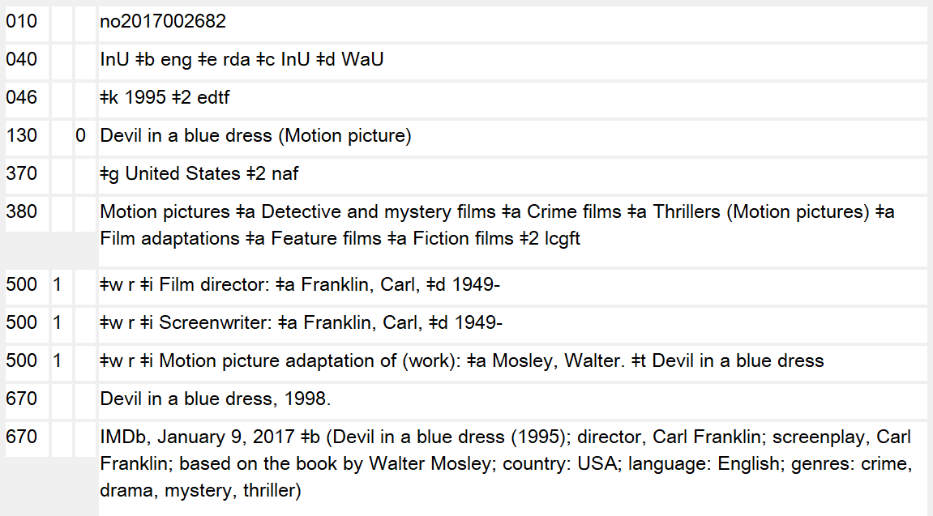
Form of Work (RDA 6.3)
Notes:
March 3, 2020: updated notes
Subfield $a in field 380 is repeatable, so multiple appropriate terms may be recorded. Alternatively, the field can be repeated with a single term in each. Either is correct.

Slide 65
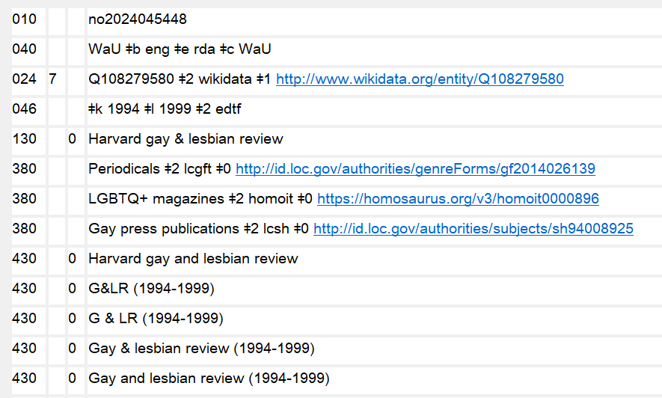
Form of Work (RDA 6.3)
Notes:
October 11, 2024: new slide
If terms used come from different controlled vocabularies, separate fields must be used.
Also, if $0/$1 are used, separate fields must be used for each term, even if the terms come from the same vocabulary.

Slide 66
Exercise: Form of work
What is the form of work for Piedra de sol and Iliad?
Each work is a poem. The Iliad is an epic poem.
Possible answers:
380 Poem or
380 Epic poem
380 Poems $2 aat and/or
380 Epics $2 aat
380 Poetry $2 lcgft or
380 Epic poetry $2 lcgft
Add form of work to your authority records.
Notes:
February 2017
ANIMATED SLIDE: Suggested answers enter on clicks.
Note you can record more than one. So for the Iliad it might be appropriate to record both “Poems” and “Epics” from the Art and Architecture Thesaurus.
380 Poems $a Epics $2 aat

Slide 67
Date of Work (RDA 6.4)
Definition: Earliest date associated with a work
  Date work was created
  If the date of creation is unknown, use the date of the earliest known manifestation embodying the work
  Can include beginning date and ending date if work was created over a period of time (e.g., a series, a television program)
Date is core only if needed to differentiate between a work and other entities with the same name
The element may be recorded whether needed to distinguish or not
Notes:
December 16, 2019: updated third subbullet under first bullet
Despite the definition of “earliest date associated with a work,” a range of dates may be recorded if appropriate.
There are special instructions for recording dates for musical works and legal works.
Presenter—there may be a question about how to code when only the ending date is known for a work whose creation span is greater than a year. The caption and scope note for subfield $l in 046 reads in MARC21:
$l - Ending date created
Ending date of the date range for which the beginning date is recorded in $k.
Subfield $l is normally recorded with a corresponding subfield $k, but may be recorded alone if only the ending date, and not the beginning date, is known.

Slide 68
Date of Work (RDA 6.4)
Notes:
December 16, 2019
Single date of work recorded in 046 $k

Slide 69
Date of Work (RDA 6.4)
Record dates according to the Gregorian calendar (LC-PCC PS)
Date is recorded in MARC 046
  Beginning date or single date = $k
  Ending date = $l
  Single or starting date for aggregated content = $o
  Ending date for aggregated content = $p
Except for century dates, this element is recorded in MARC 046 in the format YYYY-MM-DD or YYYY-MM or YYYY (using the EDTF format, with $2 edtf).
EDTF format: http://www.loc.gov/standards/datetime/. See this website for more complex situations.
Century dates do not follow the EDTF format. Simply record the first two digits of the century (e.g. “19” = all dates beginning with “19” = 20th century) with no $2.
Notes:
March 7, 2019: added info about subfields $o and $p

Slide 70
Date of Work
Aggregates/Compilations
Use 046 $k/$l for dates associated with the creation of the compilation itself
Use 046 $o/$p for dates of original creation of the contents of a compilation
046 $k 1977 $l 1984 $o 1640 $p 1770 $2 edtf
130 _0 Italian opera, 1640-1770
380 Operas $a Scores $a Facsimiles $2 lcgft
Notes:
March 3, 2020: updated speaker note
The aggregate work “Italian opera, 1640-1770” was created between 1977 and 1984; the works contained in the aggregate were created between 1640 and 1770. Using this MARC coding we can record both the dates of the aggregate as well as the dates of the individual works within the aggregate.

Slide 71
Exercise
Piedra de sol
This work was first published in 1957. The cataloger has no other information about the date of the work.
046 $k 1957 $2 edtf
Exercise: add this field to the appropriate RDA authority record.
Notes:
March 5, 2020: updated note
ANIMATED SLIDE: Suggested answer enters on click.
Note: in PDF handouts, the answer will already appear.

Slide 72
Exercise
Iliad
According to Brill’s New Pauly this work was created in the second half of the 8th century BC.
046 $k -07
Exercise: add this field to the appropriate RDA authority record.
Notes:
March 5, 2020: updated notes
ANIMATED SLIDE: Suggested answer enters on click.
Explain about BC dates.
Note: in PDF handouts, the answer will already appear.
Century dates are not recorded using EDTF.

Slide 73
Place of Origin of Work (RDA 6.5)
Definition: country or other territorial jurisdiction from which a work originated
Not the setting of the work (what the work is “about”)
Information may be taken from any source
Place of origin is core if needed to differentiate
Whether core or not, the element may be recorded
Place of origin is recorded in MARC 370 subfield $g. Other associated places of works may be recorded in $c and/or $f (e.g., setting of a work)
Associated dates may be recorded in MARC 370 subfields $s (start) and $t (end)
Notes:
October 11, 2024: revised speaker notes; $i is now permitted
December 16, 2019: added to sixth bullet; added speaker notes on setting in 370
Speaker note: It seems unlikely that a place of origin would have a start and end date, but if necessary the subfields are available.
Note: Although the slide cautions against recording setting of work in this element (370 $g), there is a way to record setting of a work in the 370 field, using subfield $i and $f (other associated place). For example:
370 ## $i Setting: $f Las Vegas (Nev.) $2 naf

Slide 74
Place of Origin of Work (RDA 6.5)
Form governed by RDA 16.2.2.4, but PCC policy is:
  For jurisdictions, use the authorized form in LC/NACO Authority File
  370 $g Paris (France) $2 naf
  370 $g United States $2 naf
  For details see Module 1 (NACO Foundations)
For non-jurisdictions, use LCSH or other sources. Record in the exact form found, and add $2 with appropriate source code:
  370 $g Pompeii (Extinct city) $2 lcsh
  370 $g Riviera (France) $2 lcsh
  370 $g Far East $2 mesh
  370 $g Saguenay Region (Québec) $2 cash
Notes:
August 27, 2019: updated to show other vocabularies may be used besides NAF and LCSH
Speaker note: For jurisdictions, use the form found in the NAF. However, the place does not need to be established in LC/NACO Authority File to record it in 370. If not established, record in the form it would have taken had it been established.
For non-jurisdictions, headings found in LCSH or other vocabularies (e.g., FAST, MeSH, CaSH (Canadian Subject Headings)) may also be used. The MARC 21 format for 370 $2 says: “Code from: Subject Heading and Term Source Codes.” The DCM Z1 370 says: “For non-jurisdictions, prefer names from an authorized vocabulary such as LCSH and identify the source in subfield $2. If the name is not found in an authorized vocabulary, record it in field 370 without giving a subfield $2 (it is not necessary for SACO participants to submit a subject heading proposal.)”

Slide 75
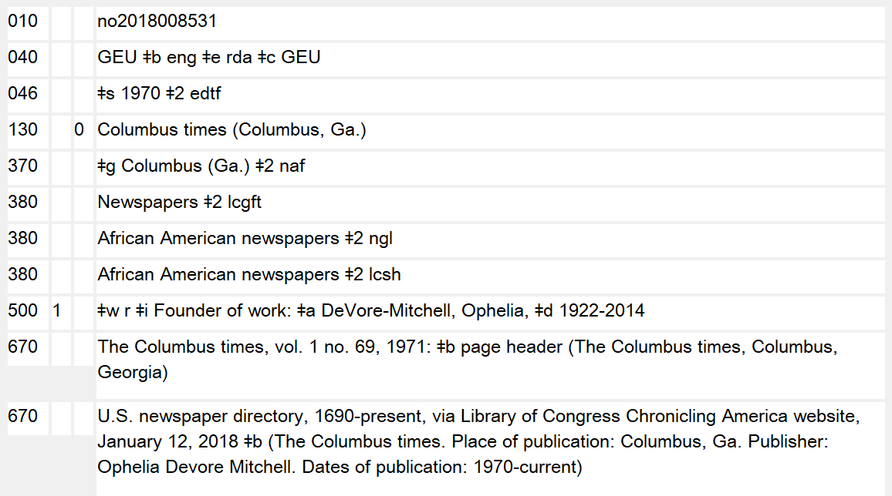
Place of Origin of Work (RDA 6.5)
Notes:
December 16, 2019
Place of origin of work in 370 $g. In this example the place of origin is needed to differentiate this work from others, so it is also included in the authorized access point.

Slide 76
Place of Origin of Work (RDA 6.5)
Notes:
December 16, 2019
Place of origin of work in 370 $g. In this example the place is not needed to differentiate this work from others, so it is not included in the authorized access point.

Slide 77
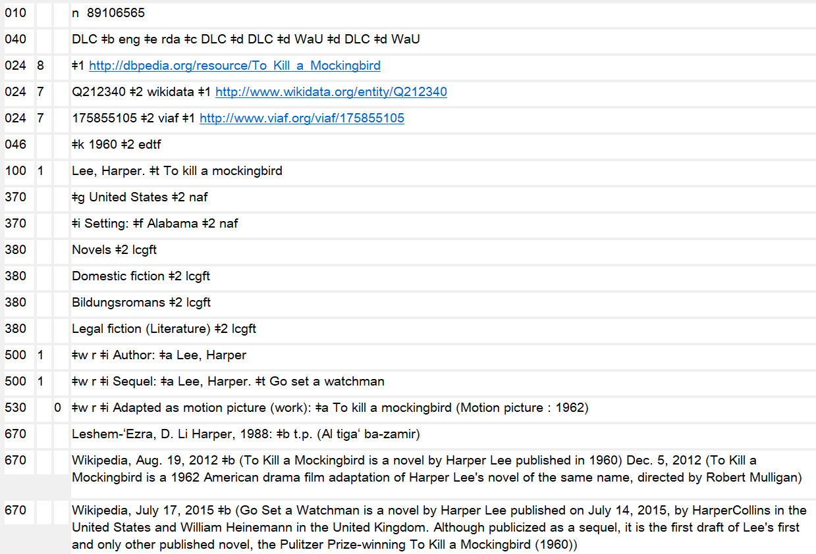
Setting of Work
Notes:
February 28, 2020: new slide to show how setting may be recorded
Setting is not an RDA element, but it may be recorded in work authority records by using the MARC relator term “setting” in 370 subfield $i, and a place in $c or $f.

Slide 78
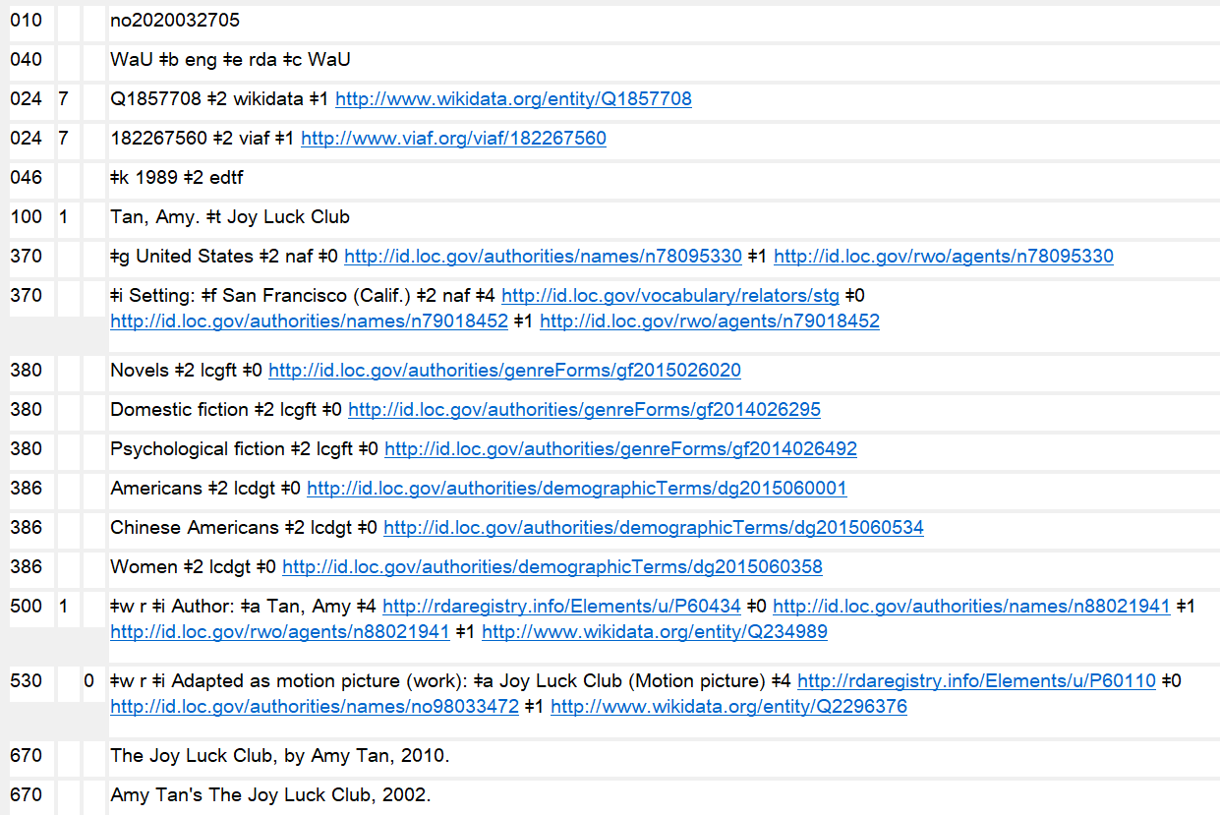
Notes:
October 11, 2024: new slide
The slide shows the use of $0, $1, and $4 in field 370 (as well as other fields). $4 contains a URI for the relationship that is specified in $i, in this case the MARC relator code URI for “setting.” $0 is used for the URI for the authority record for the places recorded, and $1 contains the real world object URIs.

Slide 79
Exercise
Piedra de sol
  The cataloger only knows that the place of origin of Piedra de sol is Mexico.
  This place is established as Mexico
    370 $g Mexico $2 naf
Exercise: Record place of origin in the authority record
Notes:
March 5, 2020: updated note
ANIMATED SLIDE: Suggested answer enters on click.
Note: in PDF handouts, the answer will already appear.

Slide 80
Work Authority Record
Iliad
  According to Brill’s New Pauly, this work was created in Ionia (Asia Minor).
  Ionia is established in LCSH; Asia Minor is established as Turkey in NAF
    370 $g Ionia (Turkey and Greece) $2 lcsh
    370 $g Turkey $2 naf
Exercise: Record place of origin in the authority record
Notes:
March 5, 2020: updated notes
ANIMATED SLIDE: Suggested answer enters on click.
Note: in PDF handouts, the answer will already appear.
Note: since the places came from different thesauri (LCSH and NAF) they have to be recorded in separate 370 fields.

Slide 81
Other Distinguishing Characteristic of Work (RDA 6.6)
A characteristic other than form, date, place of origin
Core if needed to differentiate
May be recorded, whether needed to distinguish or not
Examples: corporate bodies, qualified genre/form terms, names of persons, characterizing words
MARC coding: Use 381 field
Notes:
Updated November 13, 2014
“Qualified genre/form terms” would be something like “Anglo-Saxon poem”, which would differentiate one poem from another poem with the same preferred title that was in a different language, like “Middle High German poem.” The surnames of the directors might be used as a differentiating element for two films with the same title that were released in the same year.

Slide 82
Other Distinguishing Characteristics
046 $k 1965 $2 edtf
130 _0 Harlow (Motion picture : 1965 : Segal)
380 Motion pictures $2 lcgft
381 Segal
500 1 $w r $i Film director: $a Segal, Alex, $d 1915-1977
130 _0 Bulletin (Duke University. School of Forestry)
370 $g Durham (N.C.) $2 naf
380 Series (Publications) $a Monographic series $2 lcsh
381 Duke University. School of Forestry $2 naf
Notes:
February 28, 2020: corrected $2 coding in 380 of second example
December 16, 2019: deleted uncontrolled “Motion picture” in 380, since PCC policy is to prefer controlled vocabulary; added second example of series (common use of other distinguishing characteristic as a qualifier)
September 17, 2018: moved $w to beginning of 500 field
March 22, 2017: added controlled vocabulary to 380, added $a’s for consistency with other example
Note also the date and the form of work in this example. All three elements were required in this case to distinguish this work from other works with the same title.

Slide 83
Other Distinguishing Characteristics
046 $k 1495˜ $l 1497 $2 edtf
100 0_ Leonardo, $c da Vinci, $d 1452-1519. $t Last supper
370 $g Milan (Italy) $2 naf
380 Mural or Mural paintings (visual works) $2 aat
381 Santa Maria delle Grazie (Church : Milan, Italy) $2 naf
678 The Last Supper is a fresco depicting the Last Supper as told in the Gospel of John. It was begun about 1495 and completed in 1497 by Leonardo da Vinci in the monastery of Santa Maria delle Grazie in Milan, Italy.
Notes:
March 22, 2017: added controlled vocabulary to 380, reordered fields, revised speaker notes
Note also the dates, the place of origin, and the form of work in this example. In this case other distinguishing characteristic was not needed to distinguish this work from others, but it may be included in the record anyway.
Note: if speaker wishes to comment on this, no LCSH term was adequate for the form.

Slide 84
History of Work (RDA 6.7)
Not core
Intended for public
Record a brief narrative concerning
  Publication history (dates, publishers, places, awards)
  Relationships with other works
  Variant titles
MARC field 678, no indicators
Notes:
May 1, 2013
History of the work is not recorded as part of an access point. An example of the last point under the narrative bullet would be the example in RDA of the Book of the Dead, where this access point is used to name a corpus of works that varies in size and content from one manifestation to the next.

Slide 85
History of Work (RDA 6.7)
046 $k 1495˜ $l 1497 $2 edtf
100 0_ Leonardo, $c da Vinci, $d 1452-1519. $t Last supper
370 $g Milan (Italy) $2 naf
380 Mural or Mural paintings (visual works) $2 aat
381 Santa Maria delle Grazie (Church : Milan, Italy) $2 naf
678 The Last Supper is a fresco depicting the Last Supper as told in the Gospel of John. It was begun about 1495 and completed in 1497 by Leonardo da Vinci in the monastery of Santa Maria delle Grazie in Milan, Italy.
Notes:
Updated March 22, 2017

Slide 86
Identifier for Work (RDA 6.8)
MARC field 010 (system-assigned)
MARC field 024—some examples
  ISTC (text)
  ISWC (music)
  ISAN (audio/visual)
  ISRC (recordings) (expression)
  Others (Wikidata, FAST, VIAF, IMDb, AllMusic, etc.)
Notes:
Dec. 23, 2020: Edited speaker notes to remove references to 024 moratorium; deleted asterisk from slide.
March 5, 2020: Updated notes.
ISTC = International Standard Text Code
ISWC = International Standard Musical Work Code
ISAN = International Standard Audiovisual Number
ISRC = International Standard Recording Code

Slide 87
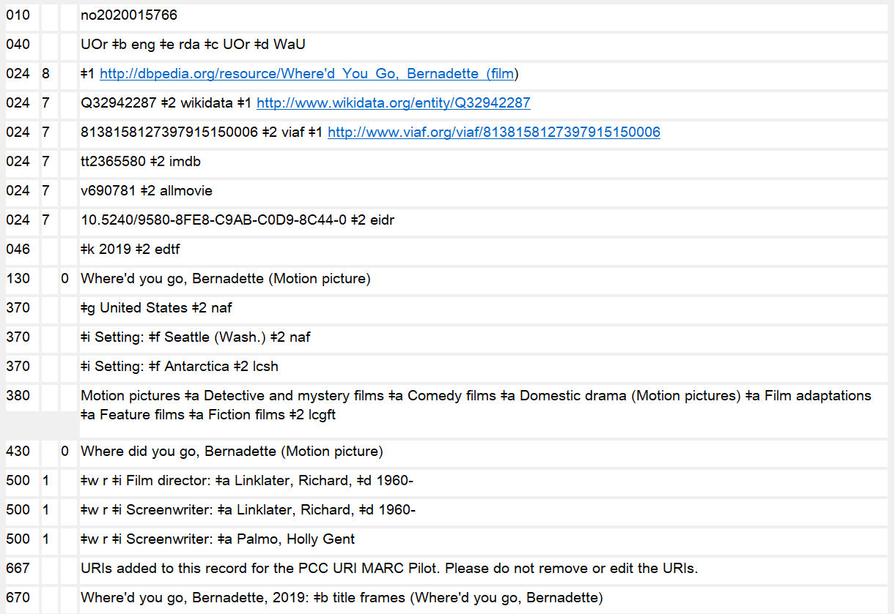
Identifier for Work – 024 Field
Notes:
October 11, 2024: updated notes to indicate that the 667 field is no longer required and may be deleted
August 16, 2023: updated notes to indicate that 024 field URIs may be added.
Dec. 23, 2020: Edited speaker notes to remove references to 024 moratorium, deleted asterisk from slide, and added “Field” to slide title.
February 28, 2020: updated screenshot and notes.
NACO catalogers may add URIs to the 024 field following the guidance at: NACO 024 Best Practices Guidelines.
The 667 note shown in the slide, which was used during the URIs in MARC Pilot project, is no longer required, and may be deleted from records when they are being revised for any reason.

Slide 88
Non-RDA Attributes of Works
Audience Characteristics – MARC 385
Creator/Contributor Characteristics – MARC 386
Notes:
May 28, 2024: revised speaker notes
February 29, 2020: added to speaker notes
LCDGT has been developed for use in these fields. The LCDGT manual provides guidance of assigning audience and creator/contributor characteristics: https://www.loc.gov/aba/publications/FreeLCDGT/freelcdgt.html
The DCM Z1 for fields 385 and 386 also provides guidance.

Slide 89
MARC 385 – Audience Characteristics
Indicators both blank
Subfields:
  $a – Audience term (R)
  $b – Audience code (R)
  $m – Demographic group term (NR)
  $n – Demographic group code (NR)
  $0 – Authority record control number or standard number (R)*
  $1 – Real World Object URI (R)*
  $2 – Source (NR)
  $3 – Materials specified (NR)
Notes:
August 16, 2023: updated notes to indicate that subfield $0/$1 may be added by NACO participants.
March 5, 2020: updated speaker notes for $0 and $1
Field Definition and Scope
A category of persons for which a resource is intended or a category of persons representing the intellectual level for which the content of a resource is considered appropriate.
If a demographic group is not specified then multiple audience characteristics from the same source vocabulary or code list may be recorded in the same field in separate occurrences of subfield $a and subfield $b. If a demographic group is specified then the characteristics in the field must all come from the same group. Terms from different source vocabularies are recorded in separate occurrences of the field.
NACO catalogers may add subfields $0 and $1 to NACO authority records. Follow the guidance and examples in NACO 024 Best Practices Guidelines.

Slide 90
MARC 386 – Creator/
Contributor Characteristics
Indicators both blank
Subfields:
  $a – Creator/contributor term (R)
  $b – Creator/contributor code (R)
  $i – Relationship information (R)
  $m – Demographic group term (NR)
  $n – Demographic group code (NR)
  $0 – Authority record control number or standard number (R)*
  $1 – Real World Object URI (R)*
  $2 – Source (NR)
  $3 – Materials specified (NR)
  $4 – Relationship (R)*
Notes:
August 16, 2023: updated notes to indicate that subfield $0/$1 may be added by NACO participants.
March 5, 2020: updated slide and note about $0, $1, and $4
Field Definition and Scope
A group category to which the creator(s) of a work or compilation of works, or the contributor(s) to an expression or compilation of expressions, belongs.
If a demographic group is not specified then multiple creator/contributor group categories from the same source vocabulary or code list may be recorded in the same field in separate occurrences of subfield $a and subfield $b. If a demographic group is specified then the categories in the field must all come from the same group. Terms from different source vocabularies are recorded in separate occurrences of the field.
NACO catalogers may add subfields $0 and $1 to NACO authority records. Follow the guidance and examples in NACO 024 Best Practices Guidelines.

Slide 91
MARC 385/386 $m and $n
  $m – Demographic group term (NR)
  $n – Demographic group code (NR)
  During the development of the 385 and 386 fields, it was realized that many class of persons headings belong to broader group categories that users might want to search or limit by. For example, children, tweens, teenagers, young adults, middle-aged persons, and senior citizens are all examples of age groups. Catholics, Baptists, Jews, Buddhists, Mormons, Muslims, Hindus, and Wiccans are all examples of religious groups.
  LC maintains the list of group terms and codes: http://www.loc.gov/standards/valuelist/lcdgt.html
Notes:
March 22, 2017
See http://www.loc.gov/standards/valuelist/lcdgt.html for the demographic group terms and codes.

Slide 92
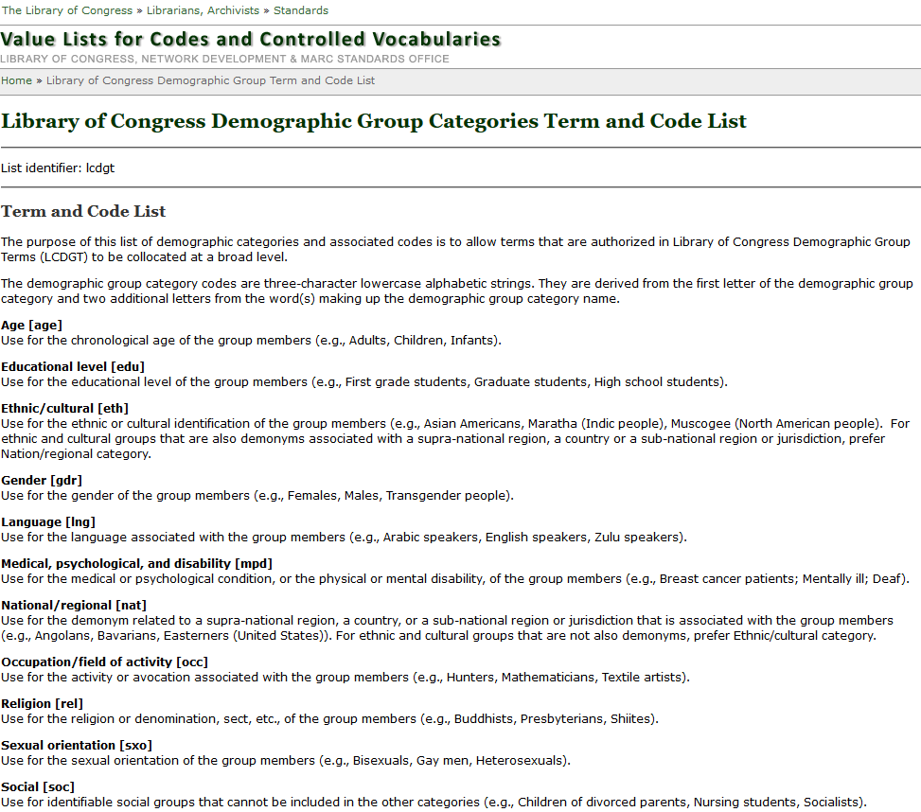
http://www.loc.gov/standards/valuelist/lcdgt.html
Notes:
March 22, 2017
These are the terms and codes that currently may be used in subfields $m and $n of fields 385 and 386.

Slide 93
385/386 Fields
$m and/or $n are optional
$2 is optional, but recommended if terms recorded are from a controlled vocabulary
May repeat $a when terms are from the same vocabulary:
386 Catholics $a Canadians $a Librarians $2 lcdgt
A work or works created by Catholic Canadian librarians
Repeat the field if $m or $n is used and terms belong to different demographic categories:
386 $n rel $a Catholics $2 lcdgt
386 $n nat $a Canadians $2 lcdgt
386 $n occ $a Librarians $2 lcdgt
Notes:
March 5, 2020: added speaker notes
Subfields $m and $n are optional. LC’s draft LCDGT Manual says that LC’s practice will be not to include either $m or $n, and that individual terms will be assigned in repeated 385 or 386 fields. So for LC, the example in the slide would be recorded as:
386 Catholics $2 lcdgt
386 Canadians $2 lcdgt
386 Librarians $2 lcdgt

Slide 94
385/386 Fields
Repeat field if terms are from different controlled vocabularies:
385 $n age $a Teenagers $2 lcdgt
385 $n age $a Adolescents $2 ericd
A work or works for teenagers
386 Indians, North American $2 mesh
386 American Indians $2 ericd
386 Indians of North America $2 lcsh
A work or works created by Native Americans
Notes:
March 5, 2020: added speaker notes
In most cases, an individual library would not want or need to add terms for the same demographic from different vocabularies. However, different libraries might prefer different vocabularies, so one library might add a term from one vocabulary and then another library might come along later and add a different term. For example, a medical library might prefer MeSH terms over LCSH or LCDGT.

Slide 95
385/386 Fields
Generally, break up compound terms into their components.
For example:
386 African American women librarians $2 lcsh
use instead:
386 African Americans $a Women $a Librarians $2 lcdgt
or
386 African Americans $2 lcdgt
386 Women $2 lcdgt
386 Librarians $2 lcdgt
A work or works created by African American women librarians
Notes:
March 5, 2020: revised speaker note
August 29, 2019: changed $2 coding to lcdgt
LC policy will be to assign terms in repeated 385 or 386 fields rather than repeating subfield $a within a field. LC will also not include subfields $m or $n. As of March 2020, there is no stated PCC policy for these various options.

Slide 96
Which Vocabularies to Use?
Any vocabularies that are on the Subject Heading and Term Source Codes list or other appropriate specialized lists such as Occupation Term Source Codes
http://www.loc.gov/standards/sourcelist/subject.html
Notes:
May 12, 2015

Slide 97
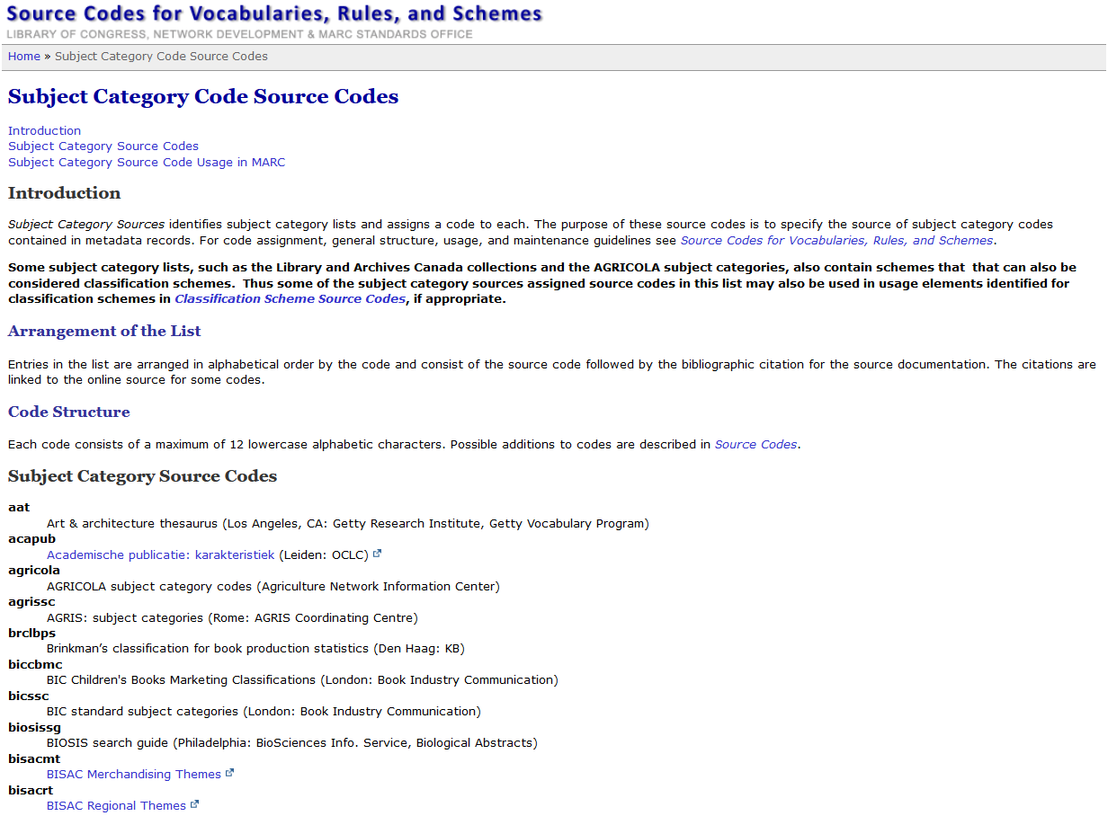
Notes:
March 5, 2020: updated slide
Screen shot of Subject Heading and Term Source Codes. It’s a very long list, and only the first ten codes in the list are shown at the bottom of the slide.

Slide 98
Which Vocabularies to Use? - LCDGT
LC has created a new vocabulary specifically for use in the 385 and 386 fields: Library of Congress Demographic Group Terms (LCDGT)
Available in Classification Web and through LC’s Linked Data Service (id.loc.gov)
LCDGT Manual is available at http://www.loc.gov/aba/publications/FreeLCDGT/freelcdgt.html
LCDGT authority records specify what demographic group categories a term falls into by using codes in 072 field
SACO libraries can propose additional terms and revisions
When using them, use $2 lcdgt in 385 and 386
Notes:
October 11, 2024: revised fifth bullet; no moratorium anymore
August 29, 2019: added parenthetical to fifth bullet about the moratorium on LCDGT proposals
The primary source for access to the approved LCDGT terms is Classification Web. Authority records in MARC UTF-8 format may be freely downloaded from http://classificationweb.net/LCDGT/, and they are also available for download in a variety of formats from LC’s Linked Data Service, http://id.loc.gov. Hopefully, with enough interest, people will convince OCLC to make the terms available through Connexion, so you can search the authorities there.

Slide 99
Which Vocabularies to Use? - LCDGT
LCDGT includes many terms that are not in LCSH:
  language speakers German speakers Vietnamese speakers
  demonyms for persons from states, provinces, regions, etc.
  Wisconsinites Newfoundlanders Tuscans
  non-U.S. ethnic groups formed as compound terms
  Japanese Canadians Greek Australians
  members of named religious denominations and political parties
  Church of Scotland members Fianna Fáil members (Ireland)
LCDGT terms may be different from LCSH:
  phrase headings instead of [Main heading]--[Subdivision] strings
  Breast cancer patients
  Native American tribal groups formed differently
  Cherokee (North American people) vs. Cherokee Indians
  new authority research might lead to choice of different authorized form
Notes:
January 21, 2016
Terms for Native American tribes are formed the same way in LCDGT as they are for other groups around the world. The term for the tribe or ethnic group is qualified by a qualifier in the form “([demonym] people)”. Hence “Cherokee (North American people)” and “Basques (European people)” and “Bengali (South Asian people)”. This provides consistency throughout the vocabulary and is less North American-centric.

Slide 100
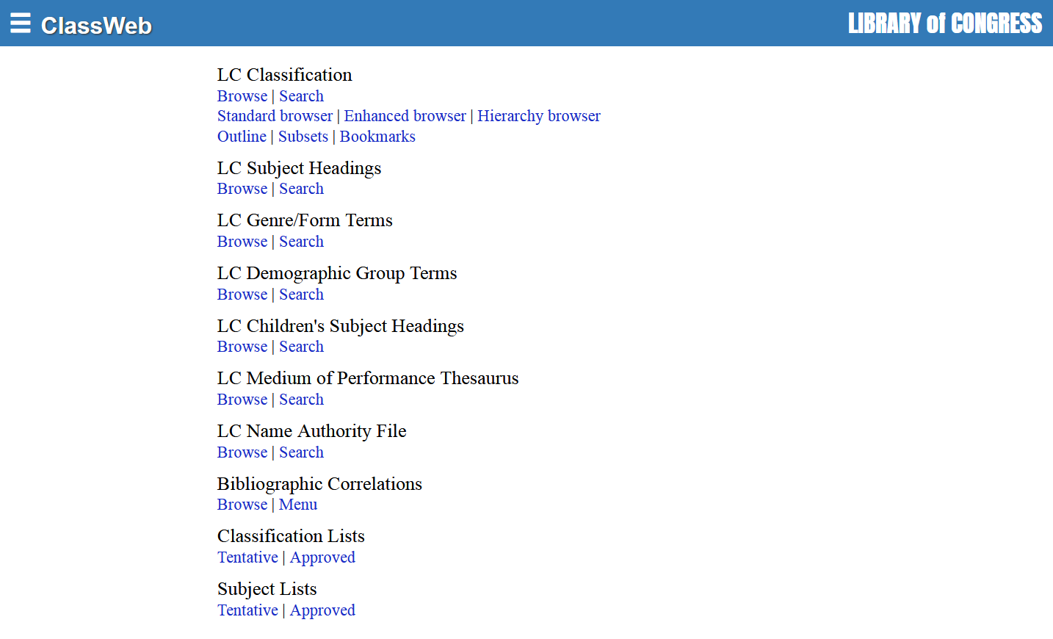
Notes:
August 29, 2019: replaced screenshot of Classification Web

Slide 101
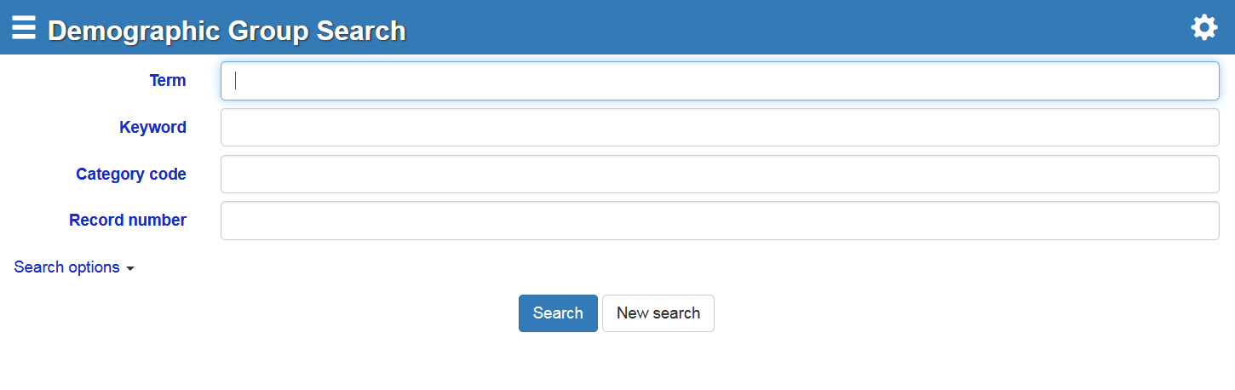
Searching by “Term” will result in a browseable list beginning with the term searched
Use the established demographic group codes in the “Category code” search and you will get a list of all of the established terms that are members of that demographic group
Notes:
August 29, 2019: replaced screenshot from Class Web

Slide 102
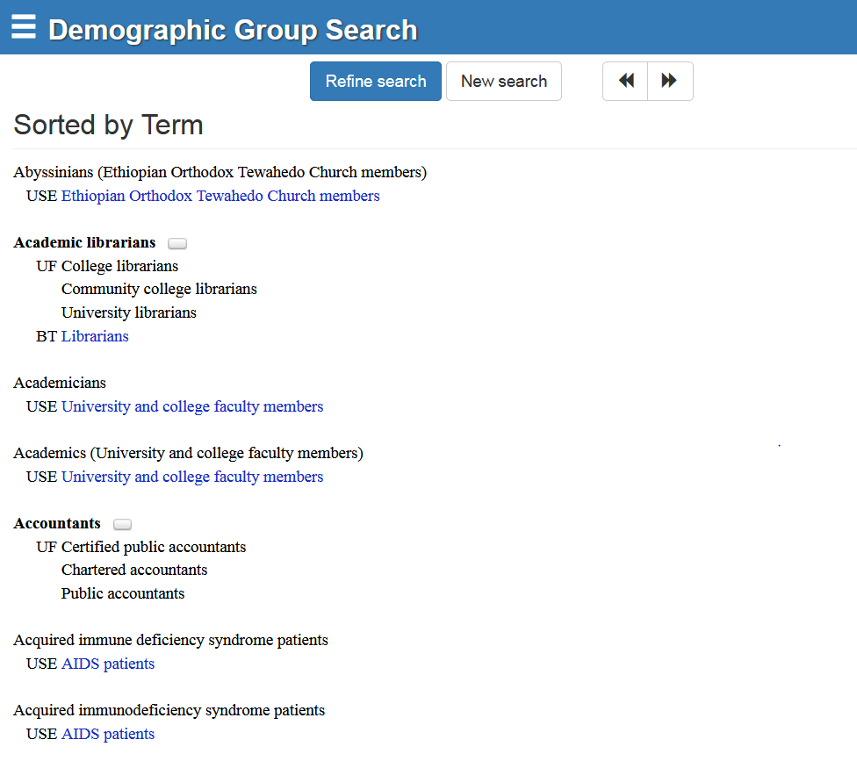
Click on bubble to view MARC record
Notes:
August 29, 2019: updated screenshot
Screenshot of LCDGT terms viewed in Classification Web

Slide 103
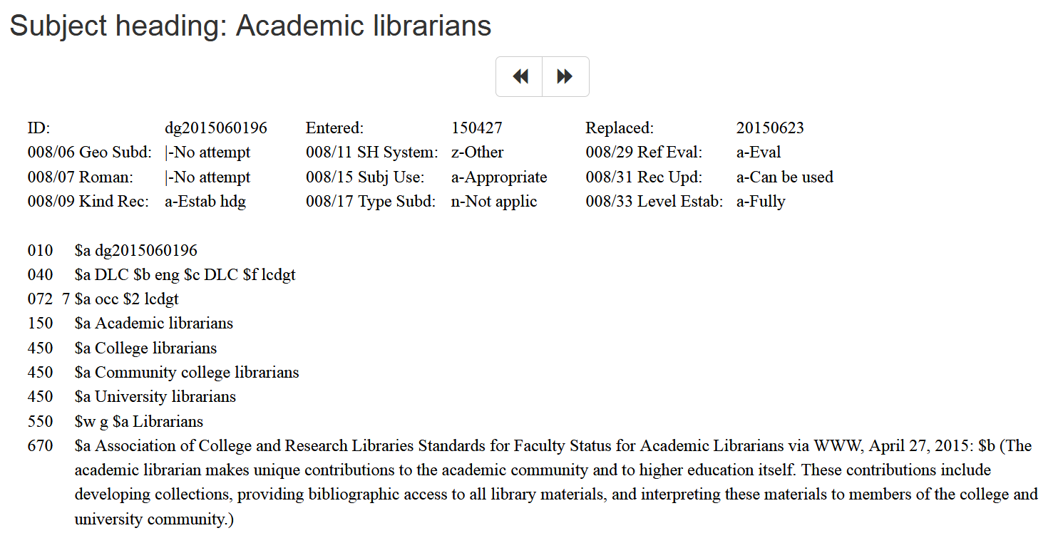
072 code indicates that this term is in the occupational group
Notes:
December 16, 2019: updated box in slide

Slide 104
Recording Audience and Creator/Contributor Characteristics
100 1_ Dees, David B. $t Quick Spanish for emergency
responders
380 Phrase books $2 lcgft
385 Emergency medical technicians $a Fire fighters
$2 lcdgt
670 Quick Spanish for emergency responders :
essential words and phrases for firefighters,
paramedics, and EMTs, 2006.
Notes:
December 16, 2019: removed the first “$a” from fields
Audience and creator/contributor characteristics may be recorded for individual works as well as for compilations of works. The authority record shown in this slide is for an individual work.
A library that uses MeSH could decide to use that vocabulary instead of or in addition to LCDGT. For example:
385 $a Emergency Responders $2 mesh

Slide 105
Recording Audience and Creator/Contributor Characteristics
100 1_ Meyer, Stephenie, $d 1973- $t Twilight
370 $g United States $2 naf
380 Novels $a Vampire fiction $a Paranormal fiction $a Romance fiction $2 lcgft
380 Young adult fiction $2 lcsh
385 Teenagers $2 lcdgt
386 Americans $2 lcdgt
386 Women $2 lcdgt
386 Latter Day Saints $2 lcdgt
Notes:
October 11, 2024: added additional 386
December 16, 2019: removed “$a” from fields
Audience and creator/contributor characteristics may be recorded for individual works as well as for compilations of works. The authority record shown in this slide is for an individual work of young adult fiction.

Slide 106
Recording Audience and Creator/Contributor Characteristics
130 _0 Anthology of North American Indian and
Eskimo music
380 Folk dance music $a Folk songs $2 lcgft
386 Indians of North America $a Eskimos $2 lcsh
430 _0 Musica degli Indiani e degli Eschimesi
dell'America del Nord
Notes:
October 11, 2024: revised speaker notes
March 5, 2020: updated notes
Audience and creator/contributor characteristics may be recorded for individual works as well as for compilations of works. The authority record shown in this slide is for an anthology of music by North American Indians and Eskimos.
The slide shows the use of LCSH terms that closely match the title of the work. Instead of, or in addition, a cataloger could add the LCDGT terms:
386 Indigenous people of America $a North Americans $2 lcdgt

Slide 107
Recording Audience and Creator/Contributor Characteristics
130 _0 Love + relAsianships
380 Drama $2 lcgft
386 $n eth $a Asian Canadians $2 lcdgt
386 $n nat $a Canadians $2 lcdgt
430 _0 Love and relAsianships
430 _0 Love plus relAsianships
670 Love + relAsianships : a collection of
contemporary Asian-Canadian drama, 2009.
Notes:
March 5, 2020: updated notes
Audience and creator/contributor characteristics may be recorded for individual works as well as for compilations of works. The authority record shown in this slide is for an anthology of plays by Asian Canadians. The cataloger has optionally chosen to include the $n category code associated with each LCDGT term assigned.

Slide 108
Attributes of Expressions

Slide 109
RDA and LC Practice
RDA (and FRBR) expect separate expression descriptions to be distinguished from one another, just as any other entity description is distinguished from others
Basic core elements for expression descriptions (RDA 0.6.6):
  Identifier for expression
  Content type
  Language of expression
Core if needed to differentiate (RDA 0.6.6):
  Date of expression
  Other distinguishing characteristic of expression
LC follows this practice except for translations
Notes:
March 22, 2017: updated RDA instruction numbers
LC also does not follow RDA practice for musical arrangements, but this NACO training does not cover music.

Slide 110
RDA and LC Practice
LC Practice for translations (LC-PCC PS 0.6.6, 6.27.3)
LC catalogers do not record elements in authority records or add elements to authorized access points to differentiate separate expressions in the same language
For example, Shakespeare’s Hamlet in French would, for LC, be represented by a single authority record and a single authorized access point even though there is more than one translation
  100 1_ Shakespeare, William, $d 1564-1616. $t Hamlet. $l French
  = all French translations of Hamlet.
Notes:
March 22, 2017: updated instruction number.

Slide 111
RDA and LC Practice
LC Practice for expressions in the original language
LC does not describe the original language expression separately from the work.
For LC, expressions in the original language are represented by the authorized access point for the work, which will be used for any expression in the original language
  100 0_ Homer. $t Iliad
  = the work Iliad and all original Greek expressions of the Iliad
Notes:
May 12, 2015
See Mail Carrier example in LC-PCC PS 6.27.3.

Slide 112
RDA and LC Practice
Exception to LC practice: If there is a name authority record with an authorized access point for an expression that includes an additional characteristic LC would not have added, LC catalogers will use that established authorized access point for that specific expression.
Notes:
May 1, 2013

Slide 113
RDA and LC Practice
PCC Catalogers may follow this LC practice, or may apply RDA and describe distinct expressions in separate authority records and assign them distinct authorized access points depending on the needs of their users.
Notes:
May 1, 2013
The following slides will discuss both practices.

Slide 114
Attributes of Expressions
Expression attributes:
  Content Type (RDA 6.9)
  Date of Expression (RDA 6.10)
  Language of Expression (RDA 6.11)
  Other Distinguishing Characteristic of Expression (RDA 6.12)
  Identifier for Expression (RDA 6.13)
Notes:
December 14, 2016: removed statement about PCC prohibition of recording content type

Slide 115
Content Type (RDA 6.9)
Content type is a core element
Definition: Content type is a categorization reflecting the fundamental form of communication in which the content is expressed and the human sense through which it is intended to be perceived.
Terms are from a controlled vocabulary listed in RDA 6.9.1.3
Notes:
March 22, 2017: removed references to RDA 5.3 and Table 6.1

Slide 116
Content Type (RDA 6.9)
Content type is recorded in MARC 336
Record the term in subfield $a; content type code may be recorded in $b; record “rdacontent” in subfield $2. Use terms and codes from RDA 6.9 and/or LC’s Term and Code List for RDA Content Types
  336 spoken word $2 rdacontent
  336 text $b txt $2 rdacontent
  336 performed music $b prm $2 rdacontent
Notes:
August 16, 2023: updated slide and notes to indicate that NACO catalogers may add URIs for content type in NACO authority records.
February 29, 2020: updated second bullet to show $b; added DCM Z1 text in speaker notes
DCM Z1: Field 336 may only be used in NARs and SARs for expressions. 336 is always accompanied by a subfield $2.
Subfield $2 – Source of term. In subfield $2 give “rdacontent.”
Subfield $a – Content type term. Use terms from RDA 6.9. The list of terms is also available in the Term and Code List for RDA Content Types at: http://www.loc.gov/standards/valuelist/rdacontent.html
Subfield $b – Content type code. If giving subfield $b instead of/or in addition to subfield $a, use the code from the MARC format Term and Code List for RDA Content Types at: http://www.loc.gov/standards/valuelist/rdacontent.html
NACO catalogers may add URIs to field 336. For example:
336 spoken word $2 rdacontent $0 http://id.loc.gov/vocabulary/contentTypes/spw

Slide 117
Content Type (RDA 6.9)
URIs may be added for content type in the 336 field. Use subfield $0:
    336 spoken word $2 rdacontent $0 http://id.loc.gov/vocabulary/contentTypes/spw
Notes:
August 16, 2023: new slide to show subfield $0 URI as content type.

Slide 118
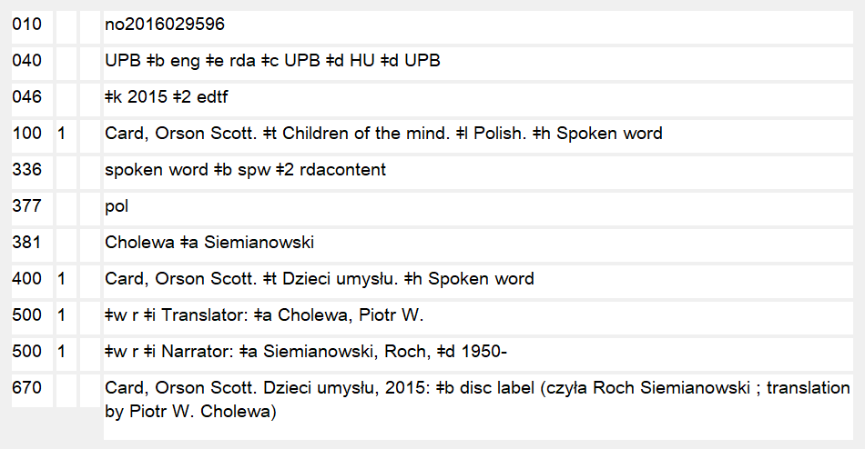
Notes:
March 5, 2020: new slide showing 336 in an NAR

Slide 119
Exercise: Content Type
Notes:
December 14, 2016: removed info about PCC prohibition
Open to 6.9. Remember, there are two expressions represented here. What is the content type of these two expressions? Take a worksheet or open a new OCLC workform to begin creating an expression description for the English translation. Record the “source consulted” in 670 and the content type in 336.

Slide 120

Exercise: Content Type
Notes:
December 14, 2016: removed info about PCC prohibition
What is the content type for these two expressions? The one on the right is an audiobook. Take two worksheets or OCLC workforms to begin an expression description for each expression. Record the source consulted element (670) content type element (336) on each. (Each was published in 2011)

Slide 121
Date of Expression (RDA 6.10)
6.10.1.1. This element records the earliest date associated with an expression. It is core if needed to distinguish between expressions.
In the absence of other evidence, the date of the earliest manifestation embodying the expression may be treated as the date of expression.
Date of expression may be recorded whether or not it is needed to distinguish
Special instructions for religious works (RDA 6.24) and for the Bible in particular (RDA 6.30.3.2)
Notes:
November 25, 2015
Separate element, part of access point, or both.

Slide 122
Attributes of Expressions: Date
Record dates according to the Gregorian calendar (LC-PCC PS)
Date is recorded in MARC 046
  Beginning date or single date = $k
  Ending date = $l
Except for century dates, this element is recorded in MARC 046 in the format YYYY-MM-DD or YYYY-MM or YYYY (using the EDTF format, with $2 edtf).
EDTF format: http://www.loc.gov/standards/datetime/. See this website for more complex situations.
Century dates do not follow the EDTF format. Simply record the first two digits of the century (e.g. “19” = all dates beginning with “19” = 20th century) with no $2.
Notes:
November 25, 2015

Slide 123
Exercise: Date of Expression
The Rukeyser translation of Piedra de sol was first published in 1963.
The Mitchell translation of the Iliad was first published in 2011.
The Alfred Molina performance of the Mitchell translation of the Iliad was first published in 2011.
Exercise: Record the date of expression element in the authority record
Notes:
May 1, 2013
Note: in fact the manifestation in which the Rukeyser translation was first published is undated; 1963 is a conjectural date, as can be seen on slide 16. Since people will have included the question mark on their 670 for this expression, they will probably notice. Remember that we’re using the evidence we have to record a date of expression; the “real” date of expression is the date the expression (e.g. a translation) was created, but usually the only evidence we have is the date of publication, which we can record. In this case we only have a conjectural date. We can still record this as the date of expression. It would be possible to record a date with a question mark in 046 using the EDTF format, but it is recommended simply to record the year that in your best judgment is the date of expression, without a question mark (in this case 1963).

Slide 124
Language of Expression (RDA 6.11)
Language of expression is a core element
Definition: “language in which a work is expressed”
RDA 6.11.1.3. “Record a language of expression using an appropriate term in a language preferred by the agency creating the data.”
Preference of NACO: Record in MARC 377, using the MARC language codes
http://www.loc.gov/marc/languages/language_name.html
Notes:
August 16, 2023: updated notes to indicate that NACO catalogers may add URIs to the 377 field.
February 29, 2020: added speaker note about the URIs in MARC Pilot Project
The underlining reinforces that in FRBR and in RDA, language is an expression-level attribute of a resource. Until or if FRBR and/or RDA incorporate a concept of Language of Work, this element will be recorded only in authority records for expressions.
For more information about recording information in the 377 field, see the NACO Foundations module.
NACO catalogers may add URIs for language in subfield $0 or $1.
Example: 377 eng $0 http://id.loc.gov/vocabulary/languages/eng

Slide 125
Language of Expression (RDA 6.11)
Note: Bilingual or polyglot editions represent more than one expression. Unlike AACR2 practice, we will never use a single authority record or authorized access point to represent such a resource in RDA
  100 1_ Shakespeare, William, $d 1564-1616. $t Hamlet. $l French & English
Notes:
May 1, 2013
Speaker note: This applies both to LC practice and possible expanded PCC practice. We’ll come back to this when we get to creating the authorized access point.

Slide 126
Exercise: Language of Expression
Record the language of expression in 377 fields on the expression worksheets or OCLC workforms you’ve started.
377 eng
NOTE: Do not record any language on the worksheets/workforms representing works. Language is not an attribute of the Work entity.
Notes:
March 5, 2020: updated notes
ANIMATED SLIDE. Suggested answer enters on click.
Note: in PDF handouts, the answer will already appear.

Slide 127
Other Distinguishing Characteristic of Expression (RDA 6.12)
Definition: “characteristic other than content type, language of expression, or date of expression serving to differentiate an expression from another expression of the same work”
Core when needed to differentiate
Special instructions for religious works (RDA 6.25)
MARC field 381
Notes:
March 22, 2017: updated to reflect current RDA language

Slide 128
Other Distinguishing Characteristic of Expression (RDA 6.12)
Use whatever distinguishes the expressions best.
  the surname of an editor or translator
  the name of a version
  the name of a publisher closely associated with the expression
  etc. ...
If it makes more sense, the language, the date of the expression, or content type can be used to distinguish instead (RDA 6.9-6.11)
Notes:
May 1, 2013

Slide 129
Exercise: Other Distinguishing Characteristic of Expression
There is more than one English expression of Piedra de sol and the Iliad.
There is more than one spoken word expression of the Iliad.
Notes:
May 1, 2013

Slide 130
Exercise: Other Distinguishing Characteristic of Expression
What might you use to distinguish these expressions?
Record your choice in 381
  Possible answers:
    381 Rukeyser
    381 Mitchell
    381 Molina or
    381 Mitchell $a Molina
Notes:
March 5, 2020: updated notes
ANIMATED SLIDE: answers will appear on each click of enter or page down
Note: in PDF handouts, the answer will already appear.
On the spoken word version of the Iliad, there are both more than one spoken word expression and there are more than one spoken word expression in English so you might need more than one other distinguishing characteristic

Slide 131
Special Rules for Expressions of Religious Works
Additional instructions to those found earlier in Chapter 6
RDA 6.24
  Date of Expression of a Religious Work
RDA 6.25
  Other Distinguishing Characteristic of Expression of a Religious Work
Notes:
May 1, 2013

Slide 132
Date of Expression of a Religious Work (RDA 6.24)
Definition: the earliest date associated with an expression of a religious work
If that date is unknown, the date of the earliest manifestation may be substituted
Bible: Record the date of the expression, not necessarily the year of publication
Use 046 (as described above)
Notes:
March 3, 2020: changed slide number in notes
The April 2015 revision clarified that the date recorded for the Bible is to be the date of the expression, not necessarily the year of publication. Versions of the Bible are often published again and again without change; these are all the same expression. The date recorded should be the earliest date associated with the expression. See also later slide 186.

Slide 133
Other Distinguishing Characteristic of Expression of a Religious Work (RDA 6.25)
RDA 6.25.1.4 gives some expression attributes unique to the Bible and parts of the Bible. If appropriate, record
  A brief form of the name of the version
    Authorized
    Vulgate
  If the version is known by the name of the translator, record it
    Lamsa
    Smith-Goodspeed
    Gordon and others
See RDA 6.25.1.4 for details and other possibilities
Record in 381
Notes:
March 22, 2017: RDA 6.25.1.4 refers specifically to the Bible not sacred scripture

Slide 134
Authorized Access Points
Notes:
May 1, 2013
Once you’ve recorded all the elements, creating the authorized access point for a work is quite easy. It is simply a matter of taking elements already recorded or found and combining them in a particular order.

Slide 135
Creating the Authorized Access Point
Follow RDA 6.27 except:
  Some musical works (RDA 6.28)
  Legal works (RDA 6.29)
  Religious works (RDA 6.30)
Series—a different workshop
Subject usage—most authorized access points can be used as subjects in LCSH
Notes:
May 1, 2013
This workshop does not deal with subject usage, but most authorized RDA access points for works and expressions can be used as subjects.

Slide 136
Constructing the Authorized Access Point for a Work (RDA 6.27.1)
In order to create the authorized access point for a work you must first ask yourself what kind of work it is:
  A work created by one agent (RDA 6.27.1.2)?
  A collaborative work (RDA 6.27.1.3)?
  A compilation of works by different agents (RDA 6.27.1.4)?
Notes:
March 22, 2017: updated to reflect current RDA language
Have workshop participants carefully think about the difference between a collaborative work and a compilation. Have examples if possible.
Agent = person, family, corporate body

Slide 137
Constructing the Authorized Access Point for a Work (RDA 6.27.1)
Works created by one agent (RDA 6.27.1.2)
  Record the authorized access point for that person, family, or corporate body (this serves as a link to the record for the creator)
  Record the preferred title of the work
Use MARC 1XX field.
  Authorized access point for creator identical to form in its own record, with identical subfield coding
  Preferred title of work in subfield $t, $n, $p, $k
Notes:
March 22, 2017: updated to reflect current RDA language

Slide 138
Constructing the Authorized Access Point for a Work (RDA 6.27.1)
Collaborative works (RDA 6.27.1.3)
  Record the authorized access point for the person, family, or corporate body with principal responsibility for the work (this serves as a link to the record for the creator) [NOTE: No “rule of three”]
  Record the preferred title of the work
Use MARC 1XX field.
  Authorized access point for principal creator identical to form in its own record, with identical subfield coding
  Preferred title of work in subfield $t, $n, $p, $k
Notes:
May 1, 2013
THIS IS A SLIGHT CHANGE FROM AACR2: No rule of three; so the person, family, or corporate body with principal responsibility is usually the first named author, no matter how many there are. This means there will be more works entered under an author’s name than there were in AACR2.
The takeaway here is that with the exception of most moving-image material, collaborative works will by and large include a name in the authorized access point.

Slide 139
Constructing the Authorized Access Point for a Work (RDA 6.27.1)
Collaborative works (RDA 6.27.1.3)
  Corporate bodies can be creators (RDA 19.2.1.1.1)
    Works of an administrative nature dealing with the body itself
    Works that record the collective thought of the body
    Works that record hearings conducted by legislative, judicial,
    governmental, and other corporate bodies
    d. Works that report the collective activity of a conference, expedition, or event
    e. Works that result from the collective activity of a performing group as a whole where the responsibility of the group goes beyond that of mere performance, execution, etc.
    f. Cartographic works originating with a corporate body
    Certain legal works (seven types listed)
    h. Named works of art by two or more artists acting as a corporate body
Module 6. Works and Expressions
139
Notes:
August 3, 2016: updated to remove eighth element from the lists of legal works – treaties no longer on the list
Read together 19.2.1.1.1
139

Slide 140
Constructing the Authorized Access Point for a Work (RDA 6.27.1)
Collaborative works exception (RDA 6.27.1.3)
  Moving image works
    The access point is created by recording the preferred title alone (does not begin with access point for a creator)
  NOTE: this applies to most motion pictures, which are usually collaborative works. If a motion picture is the work of a single person, family, or corporate body, its access point is created according to RDA 6.27.1.2 (authorized access point for creator + preferred title of the work)
Notes:
May 1, 2013

Slide 141
Constructing the Authorized Access Point for a Work (RDA 6.27.1)
Compilations of works by different agents (RDA 6.27.1.4)
  The access point is created by recording the preferred title alone (does not begin with access point for a creator)
  The preferred title is the collective title for the compilation (an aggregate work)
  If there is no collective title, separate access points are constructed for the individual works in the compilation
Notes:
March 22, 2017: updated to reflect current RDA language
Contrast compilation with collaborative work

Slide 142
Constructing the Authorized Access Point for a Work (RDA 6.27.1)
Works of unknown or uncertain attribution (RDA 6.27.1.8)
  The access point is created by recording the preferred title alone (does not begin with access point for a creator)
  If reference sources indicate that there is a probable creator, however,
      Record the authorized access point for that person, family, or corporate body (this serves as a link to the record for the creator)
      Record the preferred title of the work
Notes:
November 13, 2014
Speaker note: This is a matter of cataloger judgment. If the creator of the work is unknown, the authorized access point is the preferred title. If the work is attributed to a variety of creators and there is no consensus, the authorized access point is the preferred title. If there is consensus in reference sources (including resources embodying the work) about the probable creator, record the creator’s authorized access point as the beginning of the authorized access point for the work. Consensus does not need to be unanimous, and it just needs to indicate probable authorship. Because this is so judgment-laden, it is recommended that variant access points be made leading from name-title access points to title access points and vice versa.

Slide 143
Constructing the Authorized Access Point for Part of a Work
Generally formed in the same way as for the work as a whole
One part (RDA 6.27.2.2)
  Authorized access point for agent responsible for part (if any)
  Preferred title for part
    100 1_ Proust, Marcel, $d 1871–1922. $t Du côté de chez Swann
    not 100 1_ Proust, Marcel, $d 1871–1922. $t À la recherche du temps perdu. $p Du côté de chez Swann
Notes:
October 11, 2024: added not example to slide
December 17, 2019: corrected slide reference
Compare with discussion above at 6.2.2.9 (see slides 37-39).
Du côté de chez Swann is the first novel in a multipart monograph by Proust called À la recherche du temps perdu.

Slide 144
Constructing the Authorized Access Point for Part of a Work
One part (RDA 6.27.2.2)
  Exceptions:
    Non-distinctive title. Combine the authorized access point for the work with the preferred title for the part
      100 0_ Homer. $t Iliad. $n Book 1
    Serials/integrating resources. Combine the authorized access point for the work with the preferred title for the part
      130 _0 Acta Universitatis Upsaliensis. $p Studia musicologica
      Upsaliensia
    Television/radio programs. Combine the authorized access point for the work with the preferred title for the part
      130 _0 Simpsons (Television program). $p Bart gets an elephant
      130 _0 Downton Abbey (Television program). $n Season 3
Notes:
December 17, 2019: corrected slide reference
Compare with discussion above at 6.2.2.9 (see slides 37-39).

Slide 145
Constructing the Authorized Access Point for Part of a Work
Two or more parts (RDA 6.27.2.3)
  Consecutive numbering. Combine the authorized access point for the work with the preferred title for the sequence of parts
    100 0_ Homer. $t Odyssey. $n Book 1-5
  Unnumbered or non-consecutive numbering. Construct an access point for each part
    100 0_ Homer. $t Odyssey. $n Book 1
    100 0_ Homer. $t Odyssey. $n Book 3
    100 0_ Homer. $t Odyssey. $n Book 5
    Alternative. Combine the authorized access point for the work (or part) with the term Selections
      100 0_ Homer. $t Odyssey. $k Selections ( )
Notes:
December 17, 2019: corrected slide reference
Compare with discussion above at 6.2.2.9 (see slides 37-39).
LC practice for non-consecutive/unnumbered parts is to follow the alternative. PCC catalogers may follow either practice.
NOTE CAREFULLY: If you choose to follow the alternative, use caution. Different compilations of “selections” from Homer’s Odyssey are different aggregate works (parts of work) and their authorized access points will need to be distinguished from each other. See following section.

Slide 146
Additions to Authorized Access Points for Works
When to make additions (RDA 6.27.1.9)
  If access point is the same or similar to the access point for a different work
  If access point is the same or similar to the access point that represents an agent or place
Looking for conflicts (LC-PCC PS)
  Where to look? The “catalog” (e.g. local catalog, LC, OCLC). This is required.
  Any resource the cataloger searches, whether in a catalog or not. This is optional.
  Do not predict conflicts
Notes:
March 22, 2017: updated to reflect current RDA language

Slide 147
Access Point Same or Similar to Access Point for a Different Work
100 1_ Loos, Anita, $d 1893-1981. $t Gentlemen prefer blondes
100 1_ Loos, Anita, $d 1893-1981. $t Gentlemen prefer blondes (Play)
100 1_ Gale, Zona, $d 1874-1938. $t Miss Lulu Bett (Novel)
100 1_ Gale, Zona, $d 1874-1938. $t Miss Lulu Bett (Play)
130 _0 Under Capricorn (Motion picture)
130 _0 Under Capricorn (Series)
130 _0 Under Capricorn (Television program)
Notes:
May 12, 2015
Note coding: no subfield coding before a qualifier for a work.
Later slides cover the various elements that can be added to differentiate works, with examples, so it’s not necessary to dwell on this slide. However, explanations are provided below. This slide illustrates only one kind of element that can be added: form of work.
The first pair of examples represents a situation where the access point for the novel Gentlemen prefer blondes is already established. When the access point for the play with the same title by the same creator is needed, the newly established access point will be qualified. The already existing access point for the novel can be left unqualified.
In the second pair of examples, both access points are being established at the same time, so both are qualified.

Slide 148
Access Point Same or Similar to Access Point for a Different Work
130 0_ History of the United States (Harris, Rothman, and Thernstrom)
245 14 The history of the United States / $c edited by Neil Harris, David J. Rothman, Stephan Thernstrom.
264 _1 New York : $b Holt, Rinehart and Winston, $c 1969.
130 0_ History of the United States (Lefler)
245 12 A history of the United States : $b from the age of exploration to 1865 / $c edited by Hugh T. Lefler.
264 _1 New York : $b Meridian Books, $c 1960.
130 0_ History of the United States (Butterworth)
245 10 History of the United States / $c edited by Hezekiah Butterworth.
264 _1 New York : $b Saalfield, $c 1904.
Notes:
May 12, 2015
This slide shows a significant change from AACR2 for monograph catalogers. In RDA, works named by title alone will need to be qualified to distinguish them from other works named by title alone. The choice of qualifier is cataloger judgment. In these examples, the editor name has been used, but other choices are possible, such as date of work, place of origin, or other characteristics such as publisher name. An authority record for these is not necessarily required, unless the bibliographic record is being authenticated as a BIBCO record (042 pcc).

Slide 149
Access Point Same or Similar to Access Point for a Different Work
130 0_ Plato (Essays : Fine)
245 10 Plato / $c edited by Gail Fine.
264 _1 New York : $b Oxford University Press, $c 1999.
490 1_ Oxford readings in philosophy
130 0_ Plato (Essays : Vlastos)
245 10 Plato : $b a collection of critical essays / $c edited by Gregory Vlastos.
264 _1 Garden City, New York : $b Anchor Books, $c 1971.
Notes:
May 12, 2015
These examples illustrate that sometimes a single addition is not sufficient to distinguish works with the same title. The two works are collections of essays and the cataloger has decided to use form of work combined with another characteristic of the work, the name of the editor. Editor alone would have created a unique authorized access point, but the cataloger judged that it might not necessarily be the most comprehensible authorized access point.
Note also that these examples fall under the second category of when a qualifier is added to the access point for the work: when the authorized access point would be same as one for a person, family, corporate body, or place (next slide).

Slide 150
Needed to Distinguish Access Point from one that Represents an Agent or Place
130 0_ Beach boys (Nude photography)
245 10 Beach boys.
264 _1 [Sydney] : $b Blue Books, $c [2004]
650 _0 Photography of men.
650 _0 Photography of the nude.
130 0_ Philippines (Folk songs)
245 10 Philippines : $b musique des hautes-terres palawan.
264 _1 [France] : $b Chant du monde, $c [1987]
300 1 audio disc ; $c 12 in.
Notes:
March 22, 2017: updated to reflect current RDA language
The second reason to make an addition to an access point for a work is when the access point needs to be distinguished from one that represents an agent or place. This is a significant change from AACR2 cataloger, particularly for monographs. It means that many works named by title only when the title is the same as that of an access point for an agent or place will need to have an authorized access point for the title with a qualifier added to bibliographic records. In such cases, an NAR is not necessarily required, unless the bibliographic record is being authenticated as a BIBCO record (042 pcc).
In the first example, the title of this work consisting of photographs is identical to the authorized access point for a musical group. In the second example, the title of an audio recording of folk songs is identical to the authorized access point for a place. In both examples, form of work (which includes genres as well as forms) has been added to distinguish the works, but other choices could have been made instead (date of work, place of origin, or other distinguishing characteristic such as publisher).

Slide 151
Needed to Distinguish Access Point from One that Represents an Agent or Place
130 0_ American Museum of Natural History (Photograph)
245 10 American Museum of Natural History.
264 _0 [1892?]
300 1 photograph : $b black and white ; $c 56 x 78 cm
500 Photographer unknown.
130 0_ American Museum of Natural History (Model)
245 10 American Museum of Natural History.
264 _3 [Canada] : $b Charles Products, $c [between 1950 and 2011?]
300 1 model ; $c 3 x 10 x 3 cm
340 pewter
Notes:
February 21, 2017: changed title box

Slide 152
Additions to Authorized Access Points for Works
Other considerations (LC-PCC PS)
  Resolve conflicts by adding qualifier to the new authorized access point, not the old one (with some exceptions)
  Use an authorized access point to represent a resource when it is referred to in other authorized access points, or related to another resource by a note
  For reproductions, use the authorized access point of the original (because it’s the same work/expression)
Notes:
May 1, 2013

Slide 153
Additions to Authorized Access Points for Works: What to Add
No priority order; add whatever is appropriate
Add what you’ve already recorded as elements. Do not add any subfield coding before the qualifier(s)
  form of work (RDA 6.3) (MARC 380)
    Charlemagne (Play)
  date of work (RDA 6.4) (MARC 046 $k and/or $l)
    Dublin magazine (1762)
    Americans (Television program : 2013-2018)
  place of origin of work (RDA 6.5) (MARC 370 $g)
    Advocate (Boise, Idaho)
  and/or
  other distinguishing characteristic of work (RDA 6.6) (MARC 381)
    Bulletin (Geological Survey (South Africa))
    Harlow (Motion picture : 1965 : Douglas)
Notes:
March 3, 2020: added example of range of dates
If you’ve been recording these attributes as elements as you’ve been building up the record it is a simple matter to choose one or more of them to finish the authorized access point.
All of the examples are for works that have the same title as another work, and in these particular cases, they are not linked to a creator (as part of the access point). That is why they need qualifying.
NOTE: Date of work goes in parentheses when qualifying a work. No subfields are used. When qualifying an expression it follows a full stop and subfield $f.

Slide 154
Additions to Authorized Access Points for Works
100 1_ Keyes, Daniel. $t Flowers for Algernon
100 1_ Keyes, Daniel. $t Flowers for Algernon (Short story)
100 1_ Card, Orson Scott. $t Ender’s game
100 1_ Card, Orson Scott. $t Ender’s game (Graphic novel)
100 1_ Card, Orson Scott. $t Ender’s game (Short story)
Notes:
May 15, 2024: removed following dozen or so slides about additions to “Selections” conventional collective titles (Dickens examples); replaced with Hamlet selections examples
December 12, 2016
The previous slide showed examples of authorized access points based solely on the preferred title that needed qualifying because they conflicted with another title. This slide shows some examples of authorized access points created by combining the authorized access point for the creator with the title; these still conflict with another work, so need qualifying.
Flowers for Algernon was a short story before the author revised it to become a novel. Since the novel was established first, its authorized access point is not qualified. Later on an authorized access point was needed for the short story, a separate work. It is qualified by the form (short story)
In the second example the author wrote the short story “Ender’s game,” then the novel Ender’s game and subsequently rewrote the text for a graphic novel. This normally wouldn’t happen with a graphic novel because the adaptor is usually different from the original author and the adaptor would be considered the creator of the graphic novel, but in this case the adaptor and the original author are the same. The authorized access point for the novel isn’t qualified because it was established first and at the time there was no conflict in the database.
In each case because both the creator and preferred title are identical something needs to be added in order to differentiate these otherwise identical entities. Following PCC practice, the authorized access point that was created first was not changed; the newly-needed authorized access point is qualified to differentiate it from the existing one.

Slide 155
Additions to Authorized Access Points for Works: Conventional Collective Titles
Reminder: the term work, in RDA, refers to aggregates (collections) and components (parts) of works as well as individual works (RDA 5.1.2)
Therefore, the provisions for additions to authorized access points for works (RDA 6.27.1.9) apply to aggregates and components as well as individual works
Notes:
May 15, 2024: revised (split slide into two)
December 14, 2016: updated language to reflect current RDA

Slide 156
Additions to Authorized Access Points for Works: Selections
See above for PCC policy on partial compilations—generally the preferred title will be the title proper of the manifestation rather than a conventional collective title.
But, remember the exceptions. The preferred title of such collections may still include the word “Selections”, so there will frequently be conflict.
For example, differing selections from Shakespeare’s Hamlet have frequently been published.
Notes:
May 15, 2024: new slide

Slide 157
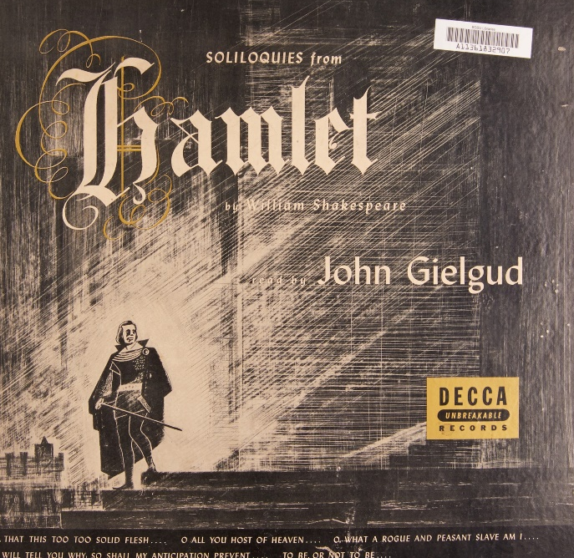


Additions to Authorized Access Points for Works: Selections
Notes:
May 15, 2024: new slide
Soliloquies from Hamlet, recording published 1947 narrated by John Gielgud
Hamlet in excerpts, published 2013
Readings from Hamlet, recording published 1967

Slide 158
Additions to Authorized Access Points for Works: Selections
Different collections or selections of parts are different aggregate works:
  Soliloquies from Hamlet, recording published 1947 narrated by John Gielgud
  Hamlet in excerpts, published 2013
  Readings from Hamlet
These each contain different parts of Hamlet
But, the RDA preferred title for each would be:
  Hamlet. Selections
Notes:
May 15, 2024: new slide

Slide 159
Additions to Authorized Access Points for Works: Selections
Based on the preferred title, the authorized access point would be:
  Shakespeare, William, 1564-1616. Hamlet. Selections
The three compilations are different works, and so cannot have the same authorized access point. They need a qualifier:
  Shakespeare, William, 1564-1616. Hamlet. Selections (…)
Notes:
May 15, 2024: new slide

Slide 160
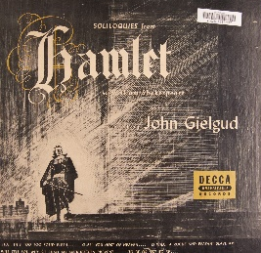


Additions to Authorized Access Points for Works: Selections
We could use form, date, place of origin, or something else to distinguish
Possibilities: Other distinguishing characteristic (title of the collection)
      100 1_ Shakespeare, William, 1564-1616. $t Hamlet. $k Selections (Soliloquies from Hamlet)
      100 1_ Shakespeare, William, 1564-1616. $t Hamlet. $k Selections (Hamlet in excerpts)
      100 1_ Shakespeare, William, 1564-1616. $t Hamlet. $k Selections (Readings from Hamlet)
Notes:
May 15, 2024: new slide

Slide 161
Additions to Authorized Access Points for Works: Selections
We could use form, date, place of origin, or something else to distinguish
Possibilities: Other distinguishing characteristic (narrator or compiler)
      100 1_ Shakespeare, William, 1564-1616. $t Hamlet. $k Selections (Gielgud)
      100 1_ Shakespeare, William, 1564-1616. $t Hamlet. $k Selections (Gocke and Quabeck)
      100 1_ Shakespeare, William, 1564-1616. $t Hamlet. $k Selections (Vaughn)
Notes:
May 15, 2024: new slide

Slide 162
Additions to Authorized Access Points for Works: Selections
We could use form, date, place of origin, or something else to distinguish
Possibilities: Other distinguishing characteristic (date of work)
      100 1_ Shakespeare, William, 1564-1616. $t Hamlet. $k Selections (1947)
      100 1_ Shakespeare, William, 1564-1616. $t Hamlet. $k Selections (2013)
      100 1_ Shakespeare, William, 1564-1616. $t Hamlet. $k Selections (1967)
Notes:
May 15, 2024: new slide
Brainstorm other possibilities: series title if it’s in a series; producer of the recording, etc.

Slide 163
Additions to Authorized Access Points for Works: Selections
Warning: The AACR2 headings for such collections found in the NAF may not be appropriate for use in RDA because they usually represented more than one work
If authorized access points are needed in RDA, they should be established on separate authority records
Notes:
May 15, 2024: title of slide revised
May 1, 2013

Slide 164
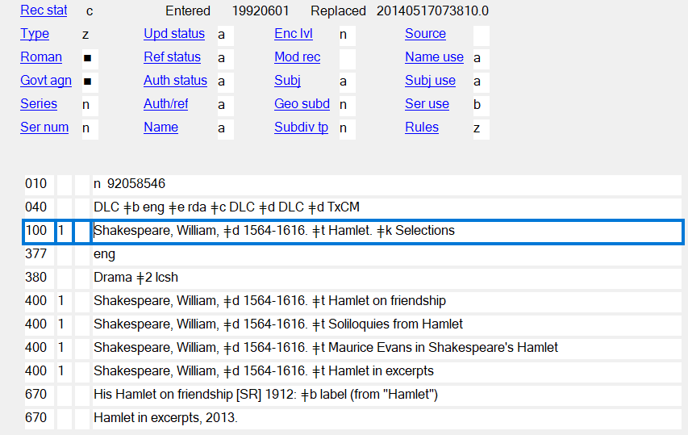
Additions to Authorized Access Points for Works: Selections
This AACR2 heading cannot be used as an RDA authorized access point because it represents different aggregate works—even though the record has been coded “rda”.
Notes:
May 15, 2024: slide replaced
May 1, 2013

Slide 165
Examples of Authorized Access Point for a Work (MARC)
    100 1_ Carter, Jimmy, $d 1924- $t Living faith
    100 1_ Smith, Joseph, $c Jr., $d 1805-1844. $t King Follett discourse
    100 1_ Ek, Mats. $t Giselle
    110 2_ Banco de Bilbao. $t Informe y memoria
    130 _0 Beowulf
    130 _0 Planet of the apes (Motion picture : 1968)
    130 _0 Encyclopaedia Britannica
    130 _0 Bible. $p Genesis
    130 _0 Bible. $p New Testament
    130 _0 NuTCRACKER (Computer file)
Notes:
May 13, 2015
NOTE: the third example, Ek, Mats. Giselle, represents a major change in practice for choreographic works. Previous to the April 2015 revision of RDA, the authorized access point for choreographic works did not begin with the authorized access point for the creator. In April 2015 RDA clarified that the authorized access points for these works should be formed the same as any other works, that is, authorized access point for the creator + preferred title. The previous form for Giselle was “Giselle (Choreographic work : Ek)”.

Slide 166
Variant Access Points for a Work
(RDA 6.27.4)
Variant access points are not core. Include them if in your judgment they would help the user find or identify the work.
  Base on a variant title (RDA 6.2.3) or the preferred title (RDA 6.2.2)
  Record in appropriate 4XX fields
  Construct the variant access point by combining the authorized access point for the creator with the variant title or a qualified preferred title or by giving the variant or preferred title alone
  Make further additions to the access point if you consider them to be important for identification in the same way such additions would have been added to a preferred title. These additions are not required.
Notes:
May 23, 2018
Read 6.27.4 together.
Note: A variant access point can be based on any title, including the preferred title.
Third bullet point. If the variant access point is based on the preferred title, it must not match the authorized access point.

Slide 167
Variant Access Point for a Work (MARC)
    400 1_ Carter, Jimmy, $d 1924- $t Personal beliefs of Jimmy Carter
    410 2_ Banco de Bilbao. $t Annual reports and accounts
    430 _0 Giselle (Choreographic work : Ek)
    430 _0 Bjowulf
    430 _0 Monkey planet (Motion picture)
    430 _0 Encyclopedia Britannica
    430 _0 Bible. $p בראשית
    430 _0 Bible. $p Καινή Διαθήκη
Notes:
May 13, 2015
NOTE: the third example, Giselle (Choreographic work : Ek), represents a major change in practice for choreographic works. Previous to the April 2015 revision of RDA, the authorized access point for choreographic works did not begin with the authorized access point for the creator. In April 2015 RDA clarified that the authorized access points for these works should be formed the same as any other works, that is, authorized access point for the creator + preferred title. The RDA authorized access point for this work is “Ek, Mats. Giselle.” The previous form “Giselle (Choreographic work : Ek)” will now be recorded as a variant access point.
Other variants are: a different title (Carter); a title in another language (Banco de Bilbao, Bjowulf); the pre-publication title of a film (Monkey planet); a variant spelling (Encyclopedia Britannica); titles in the vernacular (Bible)

Slide 168
Exercises
Complete worksheet or OCLC workform descriptions of the works Iliad and Piedra de sol
Create authority records for works that workshop participants have brought
Notes:
May 1, 2013

Slide 169
Constructing the Authorized Access Point for an Expression (RDA 6.27.3)
The authorized access point for an expression always begins with the authorized access point for the work. Record it in 1XX exactly as it was recorded in the description of the work.
Notes:
May 1, 2013
Begin filling out the 1XX fields in your authority worksheets or OCLC workforms by recording the form of the authorized access point for the work. We already did these in the previous section.

Slide 170
Constructing the Authorized Access Point for an Expression (RDA 6.27.3)
Exercise: Begin to create the authorized access point for the three expressions we’re working on by recording the authorized access point for each one’s work.
Notes:
May 1, 2013
Begin filling out the 1XX fields in your authority worksheets/OCLC workforms by recording the form of the authorized access point for the work. We just finished creating records for these.

Slide 171
Constructing the Authorized Access Point for an Expression (RDA 6.27.3)
RDA 6.27.3 says to add at least one other element
Other elements beyond the first may be added as needed to distinguish the expression from others. These may already have been recorded in the record as elements
  Content type (RDA 6.9)
  Date of expression (RDA 6.10)
  Language of expression (RDA 6.11)
  Other distinguishing characteristic of expression (RDA 6.12)
Cataloger’s judgment about which element(s) to add. What best distinguishes between the expressions?
Notes:
March 22, 2017: updated to reflect RDA language

Slide 172
Constructing the Authorized Access Point for an Expression (RDA 6.27.3)
Translations
  Always begin by adding the language in subfield $l
  Reminder: LC practice stops there, even though there may be more than one expression in the language
  There are two English-language expressions of Piedra de sol
  There are scores of English-language expressions of The Iliad
  If your library chooses to differentiate between these expressions, add another element following the language element.
    Content type – precede by period and subfield $h
    Date of expression – precede by period and subfield $f
    Other distinguishing characteristic of expression – enclose in parentheses and precede by subfield $s (except for expressions of religious works)
    Other possible combinations and orders
Notes:
March 5, 2020: added parenthetical exception for religious works; added speaker notes about subfield $h and repeatable $s; updated slide numbers in notes
Note: Punctuation for other distinguishing characteristic of expression of a religious work is different: see slides 185-186.
Note: $h was not permitted in NARs until March 2020. Until that time, NACO participants used $s for both content type and other distinguishing characteristic of expression. Catalogers should revise existing NARs that use $s for content type when they need to use that NAR in their cataloging by changing the content type subfield coding to $h. Access points in bibliographic records may also need to be revised.
Note: As of March 2020, $s is now repeatable if needed. Examples of when it would be needed:
100 1_ Langland, William, $d 1330?-1400? $t Piers Plowman $s (A-text). $l English $s (Covella)
130 _0 Herzog Ernst $s (Version B). $l English $s (Thomas and Dussère)
130 _0 Beowulf. $l English $s (Mitchell). $h Spoken word $s (Mitchell)
400 1_ Mozart, Wolfgang Amadeus, $d 1756-1791. $t Don Giovanni. $s Libretto. $l English $s (Auden and Kallman)

Slide 173
Constructing the Authorized Access Point for an Expression (RDA 6.27.3)
For this exercise, assume our library does distinguish between expressions in the same language
Let’s start by adding language to the access points for each expression to see if that’s enough to distinguish them from other expressions of the work.
Is it? If not, we can add something more.
  Possible answers:
    100 1_ Paz, Octavio, $d 1914-1998. $t Piedra de sol. $l English $s (Rukeyser)
    100 0_ Homer. $t Iliad. $l English $s (Mitchell)
    100 0_ Homer. $t Iliad. $l English. $h Spoken word $s (Molina)
    100 0_ Homer. $t Iliad. $l English $s (Mitchell). $h Spoken word $s (Molina)
or
Notes:
March 5, 2020: added another possible form for the spoken word expression
ANIMATED SLIDE: Suggested answer enters on click.
Note: in PDF handouts, the answer will already appear, so suggest that trainees not look at them.
Do the exercise together for one or two (or more), on the board.
The last one could be formed in different ways, two possibilities of which are shown in the slide.

Slide 174
Constructing the Authorized Access Point for an Expression (RDA 6.27.3)
Original language editions
  Reminder: LC practice is to use the authorized access point for the work to represent any expression in the work’s original language
  PCC catalogers may follow this practice, but in some cases may find it necessary to distinguish between expressions in the original language
  RDA 6.27.3 says to begin with the authorized access point for the work and then add one or more elements
    Content type (RDA 6.9)
    Date of expression (RDA 6.10)
    Language of expression (RDA 6.11)
    Other distinguishing characteristic of expression (RDA 6.12)
  Best practices have not yet developed (stay tuned!)
Notes:
March 22, 2017: updated to reflect RDA language

Slide 175
Constructing the Authorized Access Point for an Expression (RDA 6.27.3)
In some fields it is important to distinguish between editions in the original language. Premodern literatures are such fields.
  Some possibilities:
    Begin with language, add further elements as needed
      100 0_ Homer. $t Iliad. $l Greek $s (Murray)
      500 1_ $w r $i Editor: $a Murray, A. T. $q (Augustus Taber), $d 1866-1940
    Begin with some other element
      100 1_ Langland, William, $d 1330?-1400? $t Piers Plowman $s (Z-text)
Notes:
September 17, 2018: moved $w to beginning of 500 field
Premodern literatures are fields where it is important to distinguish between editions in the original language because there are often many different editions or versions in the original language for these texts.
Note: Best practices have not yet been established for original-language expressions, so more than one practice is shown in these slides, but from a collocation standpoint it seems best to add the original language as the first expression element when creating an authorized access point for an expression in the original language. This also parallels practice for expressions in languages other than the original language (i.e. translations).

Slide 176
Constructing the Authorized Access Point for an Expression (RDA 6.27.3)
This can happen in modern language editions as well. James Joyce’s Ulysses appeared in many versions, and it may be important to your library to bring this out
  Some possibilities:
    Begin with language, add further elements as needed
      100 1_ Joyce, James, $d 1882-1941. $t Ulysses. $l English $s (Critical and synoptic edition)
      500 1_ $w r $i Editor: $a Gabler, Hans Walter, $d 1938-
      500 1_ $w r $i Editor: $a Steppe, Wolfhard
      500 1_ $w r $i Editor: $a Melchior, Claus
    Begin with some other element
      100 1_ Joyce, James, $d 1882-1941. $t Ulysses $s (Critical and synoptic edition)
      500 1_ $w r $i Editor: $a Gabler, Hans Walter, $d 1938-
      500 1_ $w r $i Editor: $a Steppe, Wolfhard
      500 1_ $w r $i Editor: $a Melchior, Claus
Notes:
September 17, 2018: moved $w to beginning of 500 fields.=
This particular expression was published in at least two manifestations: Ulysses: a critical and synoptic edition, prepared by Hans Walter Gabler with Wolfhard Steppe and Claus Melchior (New York: Garland, 1984) and Ulysses: the corrected text, edited by Hans Walter Gabler with Wolfhard Steppe and Claus Melchior (New York: Random House, 1986)

Slide 177
Constructing the Authorized Access Point for an Expression (RDA 6.27.3)
Bilingual and Polyglot resources
  Never combine expressions in a single description/access point
    100 0_ Homer. $t Iliad. $l English & Greek
Notes:
May 12, 2015

Slide 178
Constructing the Authorized Access Point for an Expression (RDA 6.27.3)
Bilingual and Polyglot resources
  LC practice: record authorized access point for the work and authorized access point for the language of the translation
    100 0_ Homer. $t Iliad
    100 0_ Homer. $t Iliad. $l English
  PCC catalogers may follow LC practice or may distinguish between expressions within the same compilation
    100 0_ Homer. $t Iliad. $l Greek $s (Murray)
    100 0_ Homer. $t Iliad. $l English $s (Murray)
Notes:
March 22, 2017: corrected PCC practice: in the context of bilingual and polyglot resources, the expressions would not be in the same language
Since this workshop is on NACO authority records we are not talking about bibliographic records, but note that these would be recorded in a pair of 700 fields in the bibliographic record. These fields, whether following LC practice or not, would be authorized by separate authority records.

Slide 179
Additions to Authorized Access Points for Expressions: Conventional Collective Titles
“Works”
  Conventional collective title for a compilation that purports to be the complete works of an agent
  Different compilations purporting to be a creator’s complete works are treated as the same aggregate work
  If a creator’s works have been compiled more than once, the access point may need an addition to distinguish between different compilations, but this will be done at the expression level (6.27.3)
Notes:
March 22, 2017: updated to reflect current RDA language

Slide 180
Additions to Authorized Access Points for Expressions: Conventional Collective Titles
“Works”
  The pre-RDA NACO practice was always to add the date of publication to the conventional collective title “Works”
  This is not required under RDA
  The addition is only necessary if a creator’s works have appeared more than once in different expressions and the library feels it necessary to distinguish between them
  The addition should be what makes most sense to distinguish, not necessarily the date of the expression.
Notes:
May 12, 2015

Slide 181



Additions to Authorized Access Points for Expressions: Conventional Collective Titles
Three different expressions of the same aggregate work
Notes:
November 13, 2014
The great works of Thomas Paine, complete, political and theological (New York : D.M. Bennett, 1878)
The complete works of Thomas Paine (Chicago and New York : Belford, Clarke & Co., 1885). Note, this collection was first published, however, in 1880. The 1885 manifestation is a republication of the same collection, compiled by Calvin Blanchard for Belford, Clarke & Co.
The works of Thomas Paine, secretary for foreign affairs to the Congress of the United States in the late war (Philadelphia: Printed by James Carey, 1797)

Slide 182



Additions to Authorized Access Points for Expressions: Conventional Collective Titles
The authorized access point for the work is:
100 1_ Paine, Thomas, $d 1737-1809. $t Works
How can the expressions be differentiated (6.27.3)?
  Content type?
  Date of expression?
  Language of the expression?
  Other characteristic?
Notes:
May 12, 2015
Note: Any of these might be added.
Content type will not work to distinguish between these three expressions because all three have the same content type (text). However, content type might be used to distinguish these expressions and others (e.g., an audiobook (“spoken word”).
Date could be used to distinguish, but would it really help the user find the compilation he/she wants? If you choose to use the date of expression, be sure to use the true date of expression (which is not necessarily the same as the date of publication, if a particular expression has been published more than once).
Language of the expression? This would not distinguish between these three expressions, but it might be used to distinguish these expressions from others (e.g. a translation of Paine’s works into French). Note that RDA does not contain an equivalent to AACR2 25.5C1 (“If the linguistic content of the item being catalogued is different from that of the original … add the name of the language of the item to the uniform title”) so adding the language of the original expression is permitted. So “English” could be added to the authorized access point here.
Other distinguishing characteristic? Some possibilities: Editor/compiler, publisher (if a collection is associated with a particular publisher), place (probably not useful, but if a collection is closely associated with a place it might be used)
The great works of Thomas Paine, complete, political and theological (New York : D.M. Bennett, 1878)
Complete works of Thomas Paine containing all the political and theological writings (Chicago and New York : Belford, Clarke & Co., 1885). Note, this collection was first published, however, in 1880. The 1885 manifestation is a republication of the same collection, compiled by Calvin Blanchard for Belford, Clarke & Co.
The works of Thomas Paine, secretary for foreign affairs to the Congress of the United States in the late war (Philadelphia: Printed by James Carey, 1797)

Slide 183
Additions to Authorized Access Points for Expressions: Conventional Collective Titles
Possible RDA authorized access points
  100 1_ Paine, Thomas, $d 1737-1809. $t Works. $l English $s
  (Blanchard)
  100 1_ Paine, Thomas, $d 1737-1809. $t Works $s (Blanchard)
  100 1_ Paine, Thomas, $d 1737-1809. $t Works $s (Belford, Clarke &
  Co.)
  100 1_ Paine, Thomas, $d 1737-1809. $t Works. $l English $s (Belford,
  Clarke & Co.)
  100 1_ Paine, Thomas, $d 1737-1809. $t Works. $l English. $f 1880
  100 1_ Paine, Thomas, $d 1737-1809. $t Works. $f 1880
  100 1_ Paine, Thomas, $d 1737-1809. $t Works $s (Complete works of
  Thomas Paine containing all the political and theological writings)
  100 1_ Paine, Thomas, $d 1737-1809. $t Works. $l English $s (Complete
  works of Thomas Paine containing all the political and
  theological writings)
  100 1_ Paine, Thomas, $d 1737-1809. $t Works. $l English $s (Chicago, Ill.)
  100 1_ Paine, Thomas, $d 1737-1809. $t Works $s (Chicago, Ill.)
Notes:
May 12, 2015
Complete works of Thomas Paine containing all the political and theological writings (Chicago and New York : Belford, Clarke & Co., 1885). Note, however, that this collection was first published in 1880. The 1885 manifestation is a republication of the same collection, compiled by Calvin Blanchard for Belford, Clarke & Co. This manifestation was published in 1885, but the collection, the aggregate work, was first published in 1880, so the date of the expression is 1880.
Note on this and the following slides. Each slide presents several options. Only one can be chosen for each as the authorized access points. Others could be recorded as variant access points if thought useful.
Note on the language as a part of the access point: See discussion above at slides 166-167. PCC has not yet worked out policy/best practices on use of the original language in the access point for an expression when an access point is wanted at the expression level to create access points that distinguish between expressions in the same language (including the original). RDA does permit the addition of the original language to an authorized access point for an expression. Many authorized access points including the original language have already been established in the NAF under RDA. The examples here are simply given as possibilities.
Note that $s precedes the parenthetical qualifier if it represents “other distinguishing characteristic of the expression”. Reminder: similar parenthetical qualifiers at the work level (i.e. to distinguish between different works with the same preferred title) are not preceded by subfield coding.
Could differentiate by name of compiler (either the person or the publisher of the compilation), by date of expression, by title of manifestation, by place of publication.

Slide 184
Additions to Authorized Access Points for Expressions: Conventional Collective Titles
Possible RDA authorized access points
  100 1_ Paine, Thomas, $d 1737-1809. $t Works. $l English $s
  (D.M. Bennett)
  100 1_ Paine, Thomas, $d 1737-1809. $t Works $s (D.M.
  Bennett)
  100 1_ Paine, Thomas, $d 1737-1809. $t Works. $f 1878
  100 1_ Paine, Thomas, $d 1737-1809. $t Works. $l English. $f
  1878
  100 1_ Paine, Thomas, $d 1737-1809. $t Works. $l English $s
  (New York, N.Y.)
  100 1_ Paine, Thomas, $d 1737-1809. $t Works $s (New York,
  N.Y.)
  100 1_ Paine, Thomas, $d 1737-1809. $t Works $s (The great
  works of Thomas Paine, complete)
  100 1_ $a Paine, Thomas, $d 1737-1809. $t Works. $l English
  $s (The great works of Thomas Paine, complete)
Notes:
March 22, 2017: revised speaker notes: differentiate by date of expression, not date of work
Could differentiate by name of compiler (here, the publisher), by date of expression, by place of publication, by title of the manifestation.
The great works of Thomas Paine, complete, political and theological (New York : D.M. Bennett, 1878)

Slide 185
Additions to Authorized Access Points for Expressions: Conventional Collective Titles
Possible RDA authorized access points
  100 1_ Paine, Thomas, $d 1737-1809. $t Works $s (Carey)
  100 1_ Paine, Thomas, $d 1737-1809. $t Works. $l English $s
  (Carey)
  100 1_ Paine, Thomas, $d 1737-1809. $t Works. $l English $s
  (Philadelphia, Pa.)
  100 1_ Paine, Thomas, $d 1737-1809. $t Works $s (Philadelphia,
  Pa.)
  100 1_ Paine, Thomas, $d 1737-1809. $t Works. $f 1797
  100 1_ Paine, Thomas, $d 1737-1809. $t Works. $l English. $f 1797
  100 1_ Paine, Thomas, $d 1737-1809. $t Works. $l English $s (The
  works of Thomas Paine, Secretary for Foreign Affairs)
  100 1_ Paine, Thomas, $d 1737-1809. $t Works $s (The works of
  Thomas Paine, Secretary for Foreign Affairs)
Notes:
March 22, 2017: revised speaker notes: differentiate by date of expression, not date of work
Could differentiate this one by name of compiler, by place of publication, by date of expression, by title of manifestation
The works of Thomas Paine, secretary for foreign affairs to the Congress of the United States in the late war (Philadelphia: Printed by James Carey, 1797)

Slide 186
Additions to Authorized Access Points for Expressions: Conventional Collective Titles
Problem: Because NACO conventions were different previous to RDA, more than one AACR2 heading may be found for the same expression of an aggregate work. These should be consolidated for use in RDA.
    100 1_ Shakespeare, William, $d 1564-1616. $t Works. $f 1974
    100 1_ Shakespeare, William, $d 1564-1616. $t Works. $f 1997
These were used for two different manifestations of the expression called The Riverside Shakespeare, published in different years. Only one authorized access point is appropriate in RDA.
Notes:
November 13, 2014

Slide 187
Additions to Authorized Access Points for Expressions: Conventional Collective Titles
Possible RDA authorized access points:
  100 1_ Shakespeare, William, $d 1564-1616. $t Works. $f 1974 or
  100 1_ Shakespeare, William, $d 1564-1616. $t Works. $l English. $f 1974
    [differentiate by date the expression was first published]
  100 1_ Shakespeare, William, $d 1564-1616. $t Works. $l English $s (The Riverside Shakespeare) or
  100 1_ Shakespeare, William, $d 1564-1616. $t Works $s (The Riverside Shakespeare)
    [differentiate by title by which the expression is known]
  100 1_ Shakespeare, William, $d 1564-1616. $t Works $s (Evans) or
  100 1_ Shakespeare, William, $d 1564-1616. $t Works. $l English $s (Evans)
    [differentiate by the chief editor/compiler of the expression, G. Blakemore Evans]
Notes:
November 13, 2013
Important note: PCC has not yet determined how to handle this for large groups of NARs such as Shakespeare, especially on the question of whether to use the original language as part of the access point.

Slide 188
Additions to Authorized Access Points for Expressions: Conventional Collective Titles
Additional problem: Because NACO conventions were different previous to RDA, one AACR2 heading may be found that represents different aggregate works. These should be split for use in RDA.
    100 1_ Shakespeare, William, $d 1564-1616. $t Works. $f 1997
In addition to The Riverside Shakespeare, this heading was used for at least three other compilations, all published in 1997. These need to be differentiated because they are separate expressions.
Notes:
December 14, 2016: corrected “separate aggregate works” to “separate expressions” in final bullet point

Slide 189
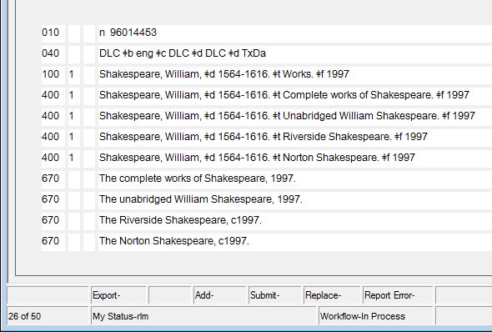
Additions to Authorized Access Points for Expressions: Conventional Collective Titles
Notes:
November 13, 2014
Added speaker note May 15, 2024
NOTE: This is similar to the NAR problem shown above with Hamlet. Selections.

Slide 190

Additions to Authorized Access Points for Expressions: Conventional Collective Titles
Possible RDA authorized access points for one of these:
  100 1_ Shakespeare, William, $d 1564-1616. $t Works $s (The
  Norton Shakespeare) or
  100 1_ Shakespeare, William, $d 1564-1616. $t Works. $l English $s
  (The Norton Shakespeare)
    [differentiate by title by which the expression is known]
  100 1_ Shakespeare, William, $d 1564-1616. $t Works. $l English $s
  (Greenblatt) or
  100 1_ Shakespeare, William, $d 1564-1616. $t Works $s
  (Greenblatt)
    [differentiate by the chief editor/compiler of the expression, Stephen Greenblatt]
  100 1_ Shakespeare, William, $d 1564-1616. $t Works. $f 1997 or
  100 1_ Shakespeare, William, $d 1564-1616. $t Works. $l English. $f
  1997
    [differentiate by date the expression was first published—unless this access point has already been used by one of the other expressions. This is probably the least useful since it does not differentiate from others published the same year]
Notes:
May 12, 2015
The Norton Shakespeare / Stephen Greenblatt, general editor ; Walter Cohen, Jean E. Howard, Katharine Eisaman Maus, [editors] ; with an essay on the Shakespearean stage by Andrew Gurr (New York: W.W. Norton, 1997)
NOTE CAREFULLY: The problem of using AACR2 forms in RDA for authorized access points with conventional collective titles applies to all conventional collective titles (e.g. “Plays,” “Correspondence,” etc.) and “Selections”, not just “Works”. On the one hand, the AACR2 authority record may represent more than one compilation, and on the other, more than one AACR2 authority record may have been used to represent what is considered in RDA to be the same aggregate work or expression of an aggregate work (e.g. because the date of manifestation was added to the heading). In RDA each compilation (aggregate work or expression or part or work or expressions) should be represented by its own record and authorized access point because each is a different work or expression.

Slide 191
Constructing a Variant Access Point for an Expression (RDA 6.27.4.5)
No variant access points are core. The decision rests with the cataloger: would it help a user find the expression?
Recorded in 4XX
Two kinds of variants
  Variants created by adding different expression attributes
    130 _0 Blade runner (Motion picture : $s Final cut)
    430 _0 Blade runner (Motion picture : $s 25th anniversary edition)
    100 1_ Shakespeare, William, 1564-1616. $t Hamlet. $k Selections (Soliloquies from Hamlet)
    400 1_ Shakespeare, William, 1564-1616. $t Hamlet. $k Selections (Gielgud)
  Variants based on a variant title for the work closely associated with a particular expression
    100 1_ Dickens, Charles, $d 1812-1870. $t Old curiosity shop. $l Hebrew
    400 1_ Dickens, Charles, $d 1812-1870. $t בית ממכר עתיקות
    400 1_ Dickens, Charles, $d 1812-1870. $t Bet-mimkar-ʻatiḳot
Notes:
February 29, 2020: added second example to first kind of variant; updated notes
May 28, 2024: replaced Racine example (which went against new PCC policy for selections) with Shakespeare example (which doesn’t)
In the first instance, the cataloger knew that this particular expression of Blade Runner was known both as the “final cut” and as the “25th anniversary edition”. “Final cut” was chosen as the distinguishing attribute for the authorized access point, but to help users that might think of this expression by the edition statement, the cataloger used that to create a variant access point. Note the MARC coding. $s precedes “Final cut” or “25th anniversary edition,” the “other distinguishing characteristic” element of the expression; but no subfield coding precedes “Motion picture,” which is a work attribute (form of work).
The second type of variant is very common with translations. In this case the Hebrew title, technically a variant title for the work, is obviously closely associated with this expression, and inclusion of it as a variant access point will help guide the user to the expression.

Slide 192
Constructing the Authorized Access Point for a Religious Expression (RDA 6.30.3.2) (Bible)
Begin with the authorized access point for the work (Bible) or part of the work
PCC practice: Include as many of the following elements as are readily ascertainable
  Language of expression (subfield $l)
  Other distinguishing characteristic of expression of a religious work, e.g. version (subfield $s)
  Date of expression of a religious work (subfield $f)
Notes:
December 17, 2019: updated slide number in speaker notes
Add as the last element of the authorized access point the date of the EXPRESSION, which is not necessarily the same as the date of the manifestation you have in your hand. Prior to the April 2015 revision RDA was somewhat ambiguous as to whether the date included in the authorized access point should be the date of publication or the date of expression. The April 2015 revision clarified this: the date of expression, not necessarily the date of publication, should be recorded. See also earlier slide 125.

Slide 193
Constructing the Authorized Access Point for a Religious Expression (RDA 6.30.3.2) (Bible)
Examples
  130 _0 Bible. $p Amos. $l English. $s Andersen-Freedman. $f 1989
  130 _0 Bible. $p Old Testament. $l English. $s NETS. $f 2007
  130 _0 Bible. $p Acts. $l Arawak. $s Shultz. $f 1850
Notes:
December 17, 2019: correct slide references in notes
Trainees may notice that the data in subfield $s in these AAPs is presented preceded by a period and outside of parentheses, while subfield $s data in the AAPs in earlier slides (e.g., 166, 168-169, 176-178) is presented within parentheses with no preceding punctuation. The explanation is to be found in RDA Appendix E.1.2.5., which details the preceding or enclosing punctuation for additions to access points. The chart at RDA E.1.1 is organized by types of access points in AACR2, hence the reference to “uniform titles.”

Slide 194
Related Works (RDA 25)
Related works are recorded in 5XX fields, and may include a relationship designator in subfield $i (from RDA Appendix J.2), with $w r.
    130 _0 Doctor Zhivago (Motion picture : 2002)
    500 1_ $w r $i Motion picture adaptation of (work): $a Pasternak, Boris Leonidovich, $d 1890-1960. $t Doktor Zhivago
    130 _0 3 men and a baby (Motion picture)
    530 _0 $w r $i Remake of (work): $a Trois hommes et un couffin (Motion picture)
Notes:
August 16, 2023: updated notes to indicate that NACO catalogers may add URIs in subfield $0 or $1 of 5XX fields.
March 3, 2020: added speaker note
NACO catalogers may add URIs in subfield $0 or $1 of 5XX fields of work and expression authority records.

Slide 195
Related Expressions (RDA 26)
Related expressions are recorded in 5XX fields, and may include a relationship designator in subfield $i (from RDA Appendix J.3), with $w r.
    100 1_ Jackson, Joe, $d 1955- $t Thief at the end of the world. $l Portuguese
    500 1_ $w r $i Translation of: $a Jackson, Joe, $d 1955- $t Thief at the end of the world
Notes:
September 17, 2018: moved $w to beginning of 500 field

Slide 196
Agents Associated with a Work or an Expression (RDA 19-20)
Agents associated with a work or an expression are recorded in 500 or 510 fields, and may include a relationship designator in subfield $i (from RDA Appendix I), with $w r.
    100 1_ Tolstoy, Leo, $c graf, $d 1828-1910. $t Voĭna i mir. $l English $s (Pevear and Volokhonsky)
    400 1_ Tolstoy, Leo, $c graf, $d 1828-1910. $t War and peace
    500 1_ $w r $i Translator: $a Pevear, Richard, $d 1943-
    500 1_ $w r $i Translator: $a Volokhonsky, Larissa
Notes:
September 17, 2018: moved $w to beginning of 500 fields, corrected RDA instruction number and element name, updated speaker notes
Agents associated with a work include creators (RDA 19.2) and other agents (RDA 19.3) such as agents to whom correspondence is addressed, persons honoured by a festschrift, directors, cinematographers, sponsoring bodies, production companies, institutions hosting an exhibition or event, etc.
Agents associated with a work are known as contributors (RDA 20.2).
Similarly, other types of relationships to an expression may be recorded (for example, to a related expression), as appropriate.
Note that the 400 field in this example does not have the parenthetical qualifier added. RDA 6.27.4.1 says “Make additions to the variant access point, if considered important for identification. Apply the instructions at 6.27.1.9 as applicable.” It’s cataloger judgment as to whether to add the qualifier.

Slide 197
Related Subjects (RDA 33-37)
Subject relationships may be recorded in 5XX fields, but only between works, or between a work and expression, and only if the related entity is in the LC/NACO Authority File.
Include a relationship designator in subfield $i (see RDA Appendix M.2.2-M.2.2.3), with $w r.
    100 1_ Jeske, John C. $t Genesis
    530 _0 $w r $i Commentary on (work): $a Bible. $p Genesis
Notes:
January 14, 2019: removed Gaskell example and revised slide and speaker notes to conform with PCC Guidelines for the Application of Relationship Designators in NACO Authority Records Guideline 16.
REMEMBER:
- Do not attempt to record relationships to subjects that are outside of LC/NAF (e.g., it is not currently permitted to record relationships to subjects in LCSH).
- Do not apply RDA Appendix M.2.4 (Manifestation as Subject of a Work), M.2.5 (Item as Subject of a Work), or M.2.6-M.2.8 (Agents as Subject of a Work).

Slide 198
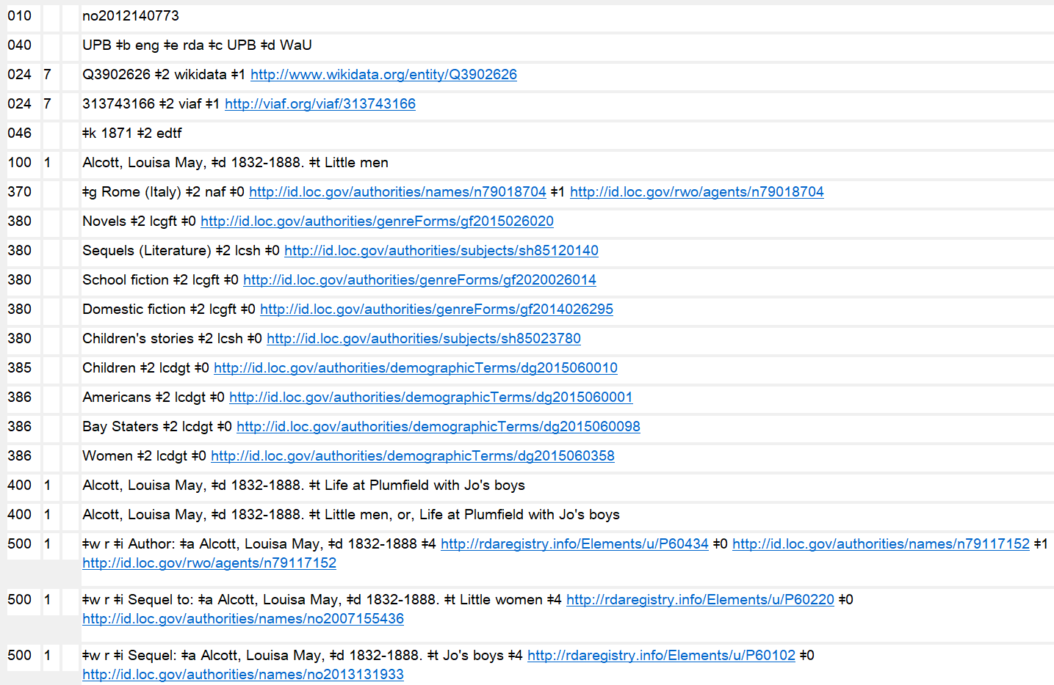
URIs in 3XX and 5XX
Notes:
July 30, 2025: updated speaker notes
October 11, 2024: new slide
As we’ve seen in other modules, catalogers may optionally add URIs in subfields $0, $1, and $4 to most fields that allow them.
URIs may be added to 3XX and 5XX fields in accordance with PCC guidelines and best practices. Tools such as the Authority Toolkit (https://files.library.northwestern.edu/public/oclc/documentation/) may be used to automatically add URI subfields. Record authority record URIs in subfield $0, real world object URIs in $1, and relationship designator URIs in $4. The recommended order of subfields is $2 $4 $0 $1. When using RDA relationship URIs in $4, use unconstrained property URIs from the RDA Registry (https://www.rdaregistry.info/Elements/u/). Consult the URIs in MARC Pilot Resource Documents & Tools website (https://wiki.lyrasis.org/pages/viewpage.action?pageId=178881300), but note that PCC documentation on URIs is currently in the process of being revised and updated.
URIs were originally added as part of the PCC’s URIs in MARC Pilot project. The 667 note “URIs added to this record for the PCC URI MARC Pilot. Please do not remove or edit the URIs” is no longer required and may be deleted when a record is being revised for any reason.
Reminder: Any authorized access point given in a 5XX field must be established in its own authority record.
$0 - authority URI
$1 - real world object URI
$4 - relationship URI

Slide 199
RDA Authority Record Core and Non-Core: Work Record
040 [MARC library code] $b eng $e rda $c [MARC library code]
046 $k 1957 $2 edtf
100 1_ Paz, Octavio, $d 1914-1998. $t Piedra de sol
370 $g Mexico $2 naf
380 Poetry $2 lcgft
386 Mexicans $a Men $2 lcdgt
670 Piedra de sol, 1957?: $b title page (Octavio Paz)
Notes:
August 29, 2019: removed Poets from 386; added Men.
RDA work elements in record:
046 $k = Date of work (RDA 6.4)
100 $t = Preferred title for work (RDA 6.2.2)
370 $g = Place of origin of work (RDA 6.5)
380 $a = Form of work (RDA 6.3)

Slide 200
RDA Authority Record Core and Non-Core: Work Record
040 [MARC library code] $b eng $e rda $c [MARC library code]
046 $k -07
100 0_ Homer. $t Iliad
370 $g Ionia (Turkey and Greece) $2 lcsh
370 $g Turkey $2 naf
380 Epic poetry $2 lcgft
386 Greeks $a Men $2 lcdgt
670 Iliad, 2011: $b title page (Homer; translated ... by Stephen Mitchell)
670 Brill’s new Pauly dictionary of Greek and Latin authors and texts, 2009, p. 325-326: $b (Iliad (English); Ilias (Latin); Ἰλιάς (Greek); poem by Homer, second half of 8th century BC, written in Ionia (Asia Minor))
Notes:
August 29, 2019: removed Poets from 386; replaced with Greeks and Men; changed 380 form Poetry to Epic poetry
RDA work elements in record:
046 $k = Date of work (RDA 6.4)
100 $t = Preferred title for work (RDA 6.2.2)
370 $g = Place of origin of work (RDA 6.5)
380 $a = Form of work (RDA 6.3)

Slide 201
RDA Authority Record Core and Non-Core: Expression Record
040 [MARC library code] $b eng $e rda $c [MARC library code]
046 $k 1963 $2 edtf
100 1_ Paz, Octavio, $d 1914-1998. $t Piedra de sol. $l English $s (Rukeyser)
336 text $2 rdacontent
377 eng
381 Rukeyser
400 1 _ Paz, Octavio, $d 1914-1998. $t Sun stone
500 1_ $w r $i Translator: $a Rukeyser, Muriel, $d 1913-1980
670 Sun stone = Piedra de sol, 1963?: $b title page (translation by Muriel Rukeyser)
Note: LC would use the following form for this and all English expressions of Piedra de sol, unless they are copy cataloging a record that differentiated the expression. Other catalogers may apply RDA (as above)
100 1 _ Paz, Octavio, $d 1914-1998. $t Piedra de sol. $l English
Notes:
September 17, 2018: moved $w to beginning of 500 field
Some suggested answers for the expressions worksheets/workforms.
In this case “other distinguishing characteristic” is core because it is needed to distinguish this English expression from another English expression: there is more than one translation. The qualifier could have also been added to the variant access point if desired.
RDA expression elements in record:
046 $k = Date of expression (RDA 6.10)
100 $l = Language of expression (RDA 6.11)
100 $s = Other distinguishing characteristic of expression (RDA 6.12)
336 $a = Content type (RDA 6.9)
337 $a = Language of expression (RDA 6.11)
381 $a = Other distinguishing characteristic of expression (RDA 6.12)
400 = Variant access point representing an expression (RDA 6.27.4.5)
500 = Contributor (RDA 20.2)

Slide 202
RDA Authority Record Core and Non-Core: Expression Record
040 [MARC library code] $b eng $e rda $c [MARC library code]
046 $k 2011 $2 edtf
100 0_ Homer. $t Iliad. $l English $s (Mitchell)
336 text $2 rdacontent
377 eng
381 Mitchell
500 1_ $w r $i Translator: $a Mitchell, Stephen, $d 1943-
670 Iliad, 2011: $b title page (translated ... by Stephen Mitchell)
Note: LC would use this form for this and all English expressions of the Iliad, unless they are copy cataloging a record that differentiated the expression. Other catalogers may apply RDA (as above)
100 0 _ Homer. $t Iliad. $l English
Notes:
September 17, 2018: moved $w to beginning of 500 field
In this case “other distinguishing characteristic” is core because it is needed to distinguish this English expression from another English expression: there are many more than one translation.
RDA expression elements in record:
046 $k = Date of expression (RDA 6.10)
100 $l = Language of expression (RDA 6.11)
100 $s = Other distinguishing characteristic of expression (RDA 6.12)
336 $a = Content type (RDA 6.9)
337 $a = Language of expression (RDA 6.11)
381 $a = Other distinguishing characteristic of expression (RDA 6.12)
500 = Contributor (RDA 20.2)

Slide 203
RDA Authority Record Core and Non-Core: Expression Record
040 [MARC library code] $b eng $e rda $c [MARC library code]
046 $k 2011 $2 edtf
100 0_ Homer. $t Iliad. $l English. $h Spoken word $s (Molina)
336 spoken word $2 rdacontent
377 eng
381 Molina
500 1_ $w r $i Narrator: $a Molina, Alfred, $d 1953-
500 1_ $w r $i Translator: $a Mitchell, Stephen, $d 1943-
670 The Iliad, 2011: $b container (translated by Stephen Mitchell ; read by Alfred Molina)
Note: LC would probably use this form for this and all English expressions of the Iliad, unless they are copy cataloging a record that differentiated the expression. Other catalogers may apply RDA (as above)
100 0_ Homer. $t Iliad. $l English
Notes:
February 29, 2020: corrected 100 field coding that is used after March 2020
In this case we’ve added content type to distinguish this expression from other English expressions, but still further differentiation is needed because there are more than one English spoken word expression of the Iliad. There are probably other ways this could be done. In this case, we added “Molina” as an “other distinguishing characteristic.” Another option would be to repeat $s to record both the translator and the narrator:
Homer. $t Iliad. $l English $s (Mitchell). $h Spoken word $s (Molina)
It’s not clear whether LC would distinguish between text and spoken word expressions in the same language. This is more than just a translation, it’s a new expression of a translation. So LC might add elements to distinguish …
RDA expression elements in record:
046 $k = Date of expression (RDA 6.10)
100 $l = Language of expression (RDA 6.11)
100 $h = Content type (RDA 6.9);
100 $s = Other distinguishing characteristic of expression (RDA 6.12)
336 $a = Content type (RDA 6.9)
377 $a = Language of expression (RDA 6.11)
381 $a = Other distinguishing characteristic of expression (RDA 6.12)
500 = Contributor (RDA 20.2)

Slide 204
Exercises
Update or add authority records for expressions workshop participants have brought
Notes:
May 1, 2013

Slide 205
Module 6
Describing Works and Expressions
Questions?
Notes:
May 1, 2013

